Slide 1
What is Healthy Soil and What are Its Enemies
Brian McConkey
Oct 2, 2019
Winnipeg

Slide 2
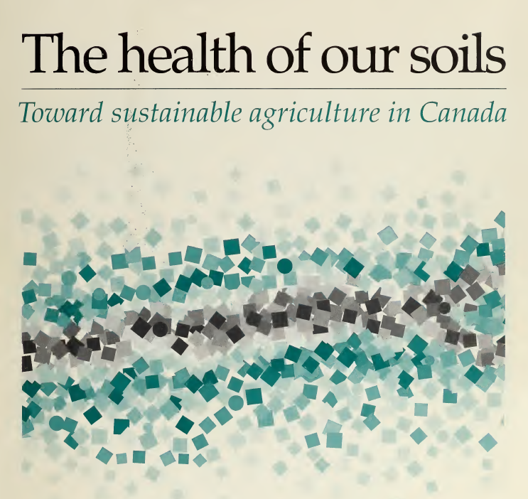
AAFC (1995): Soil health is the soil fitness to support crop growth without resulting in soil degradation or otherwise harming the environment

Slide 3
What is Soil Health?
Kibblewhite et al. (2008): Soil health is an integrative property that reflects the capacity of soil to respond to agricultural intervention, so that it continues to support both the agricultural production and the provision of other ecosystem services.
  The farmer’s stewardship is necessary and key part of what is soil health!
Efficient
Productivity +
Other Desired
Agroecosystem
Services
We know that soil health is better when
productivity and other the desired
agroecosystem services are greater
and/or more reliably obtained.
Soil Health

Slide 4
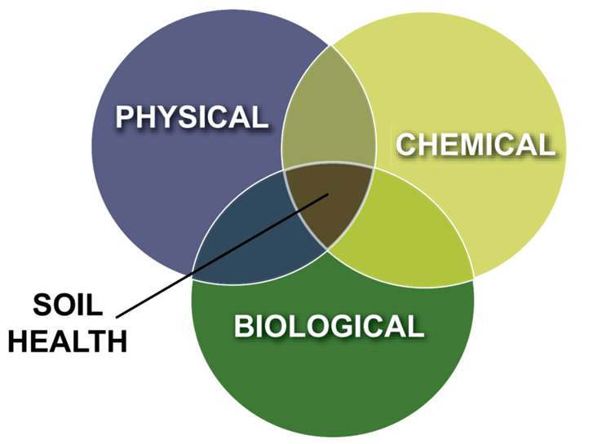
Soil Health vs Soil Quality
Most use terms interchangeability
Both based on functions provided by soil
Health probably better communicates more holistic concept regarding of entire ecosystem function
Source: Comprehensive Assessment of Soil Health, Cornell

Slide 5
Soil-based
Ecosystem Services
Biomass production and
protection
Biodiversity conservation
Erosion control
Pest and disease control
Water quality and supply
Climate Regulation
Adapted from Bünemann et al. 2018, Soil Biol. Biochem. 120:105-125

Slide 6
Soil Functions
Soil-based
Ecosystem Services
Habitat
(roots, soil organisms)
Element cycling and
buffering
Decomposition of
organic materials
Soil Structure
Maintenance
Biological population
and regulation
Water partitioning
(infiltration, retention,
percolation)
Organic matter cycling
(quality, sequestration)
Biomass production and
protection
Biodiversity conservation
Erosion control
Pest and disease control
Water quality and supply
Climate Regulation
Adapted from Bünemann et al. 2018, Soil Biol. Biochem. 120:105-125

Slide 7

Healthy soil depends on the decision maker values and geographical context
Soil health assessed by adequacy for providing soil-based function that produce desired agroecosystem services
  What is most desired is a value judgement of the decision maker.
Adequacy is context of what is agroecosystem services are achievable
  May desire consistent 300 bu corn yield but that’s not going to happen everywhere, e.g. dryland production in SW Saskatchewan
Many soil-based functions depend on factors that are inherent and essentially outside of direct management control
  Climate, weather
  Parent material texture and minerology
  Landform
  Regional hydrology (water table, flood risk)
Consequently no precise criteria for
measured attributes that define the
functional state of soil health

Slide 8
Soil Health has Local Context
Desired
Agroecosystem
Services
Local Natural Service Limit
Service for soil health state B
Service for soil health state A
A
B
C
D
Soil Health

Slide 9
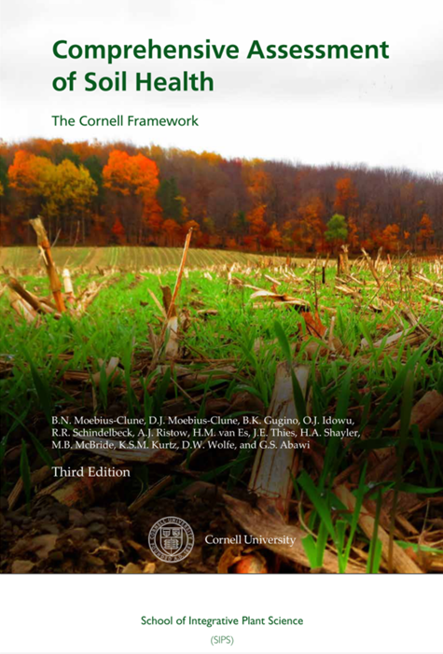
We can measure many attributes that relate to Soil Health
Soil organic matter
  Quantity of organic matter
  Quality of organic matter (active and readily decomposable forms)
Soil structure
  Bulk density
  Ability to conduct air and water through soil pores
Soil microbe
  Genomic diversity
  Activity and functioning
Contaminant content and activity
Soil pH
Soil nutrient amount and availability
Salinity
Etc.

Slide 10
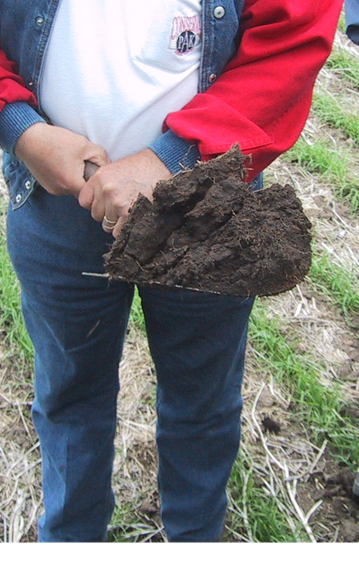
We probably spend too much effort on measuring soil chemistry compared to measuring soil structure
A simple shovel is a useful measurement instrument for assessing soil health

Slide 11
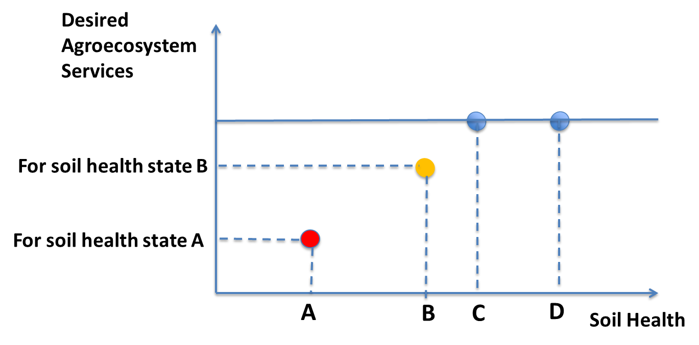
Causes of major dysfunctions can generally be determined by measurement but difficult to determine if soil health is optimal by measurements alone
Measuring differences between soil health states, A, B, and C identifies the feasible healthy soil states and what soil functions need to be addressed to improve the less healthy soils.

Slide 12
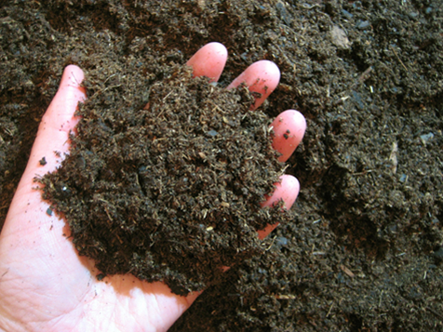
Soil Organic Matter is Critical to Healthy Soil
Soil organic matter is key to many functions
  Supporting health and diversity of soil organisms
  Nutrient cycling,
  Buffering (nutrients, cation exchange)
  Soil structure
  Water storage and partitioning
  Decomposition of organic contaminants
  Carbon sequestration

Slide 13
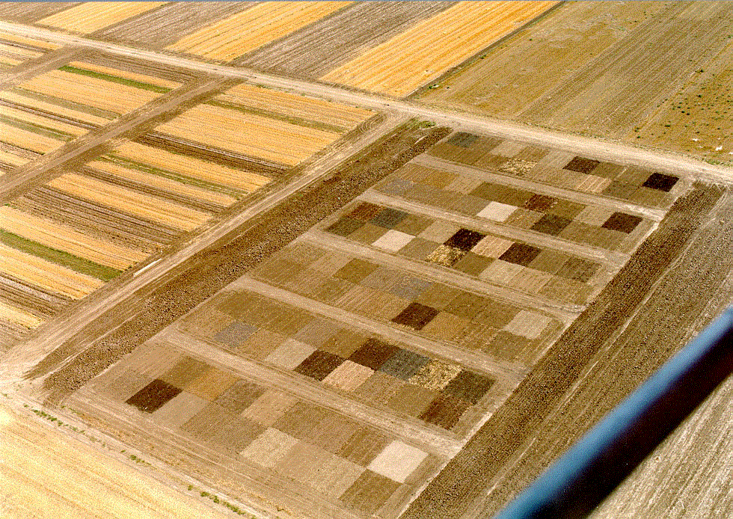
25
Soil Productivity
20
15
Productivity (Mg ha⁻¹)
10
R²=0.70
5
0
0
1
2
3
4
5
6
7
8
Organic C (%)
Notes:
Canada has conducted research at the same site that has shown why soil carbon is an important indicator of soil quality and agricultural productivity.

Slide 14
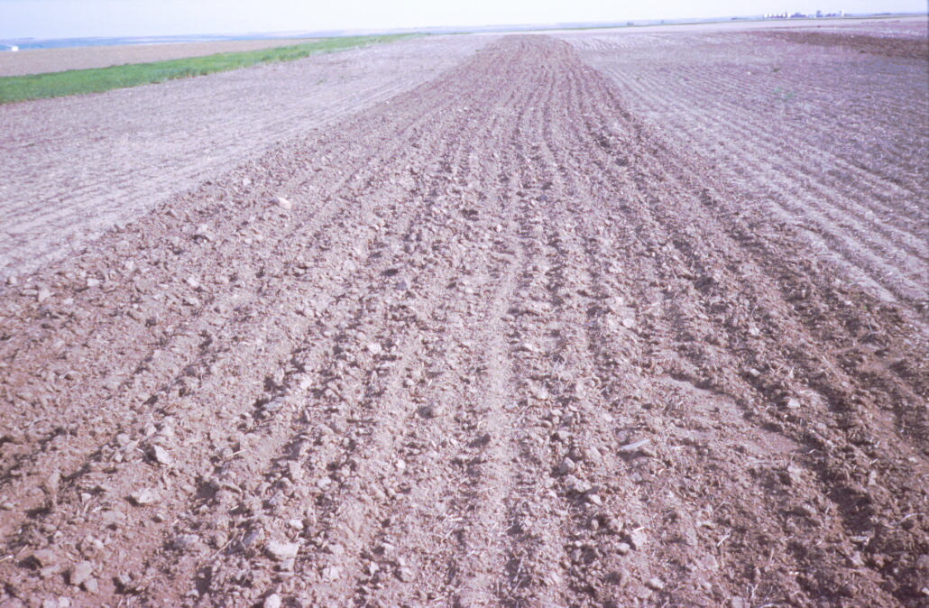
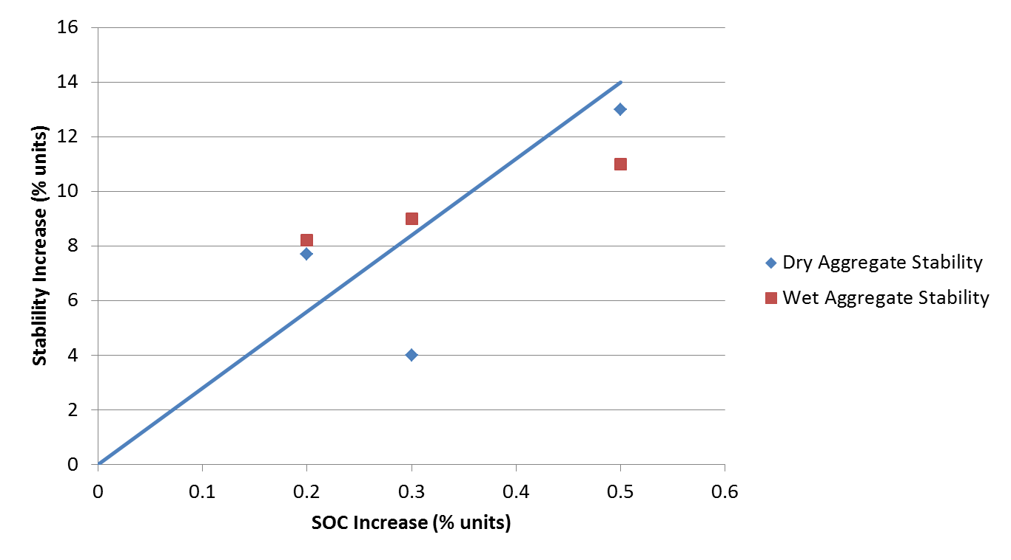
Better SOC = Better Soil Structure

Slide 15
Active (Particulate) Organic Matter (% of SOM)
Source: LeCanne and Lundgren, 2018, Regenerative agriculture: merging
farming and natural resource conservation
Profitably, PeerJ, DOI 10.7717/peerj.4428

Slide 16
Enemies of Soil Health

Slide 17

All agricultural practices stress the soil system and force it to respond
Value judgement as to what are good and bad stresses
  Stresses that increase or, at least, maintain, productivity and other desired ecosystem functions are generally considered good for agriculture
  Balance between different ecosystem services will affect if the stress is considered good or bad

Slide 18
Enemies of Soil Health
Bad soil health stressors reduce soil’s ability to provide desired functions
Poor soil functioning then becomes a constraint on the provision of ecosystem services
Desired
Agroecosystem
Services
Unrealized
potential
Services limited by
poor soil health
State of
Poor Soil
Health
Soil Health

Slide 19
Soil-based
Ecosystem Services
Bad Soil Stressors
Soil Functions
Erosion
SOM decline
Contamination
(metals, toxic organics)
Sealing
Compaction
Biodiversity loss
Salinization
Acidification
Catastrophes,
(landslides, extreme
storms and floods)
Habitat
(roots, soil organisms)
Element cycling and
buffering
Decomposition of
Organic materials
Soil Structure
Maintenance
Biological population
and regulation
Water partitioning
(infiltration, retention,
percolation)
Organic matter cycling
(quality, sequestration)
Biomass production and
protection
Biodiversity conservation
Erosion control
Pest and disease control
Water quality and supply
Climate Regulation
Adapted from Bünemann et al. 2018, Soil Biol. Biochem. 120:105-125

Slide 20
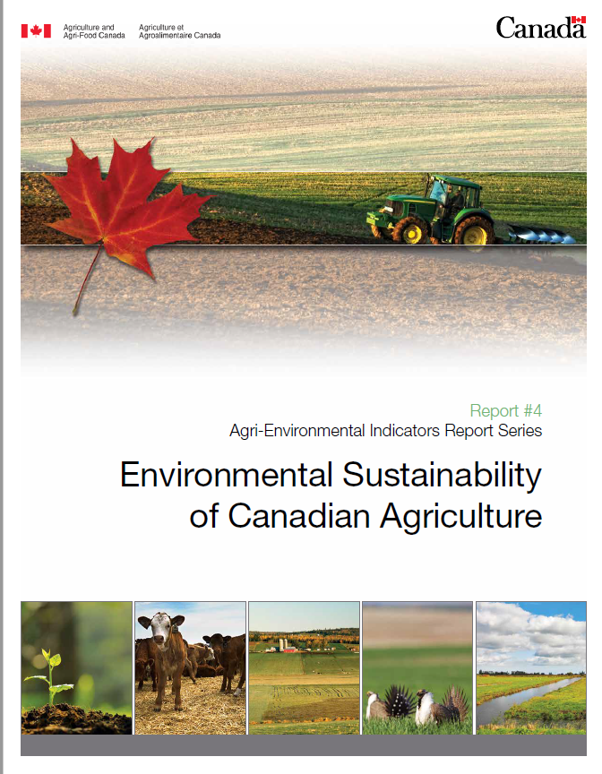

Slide 21
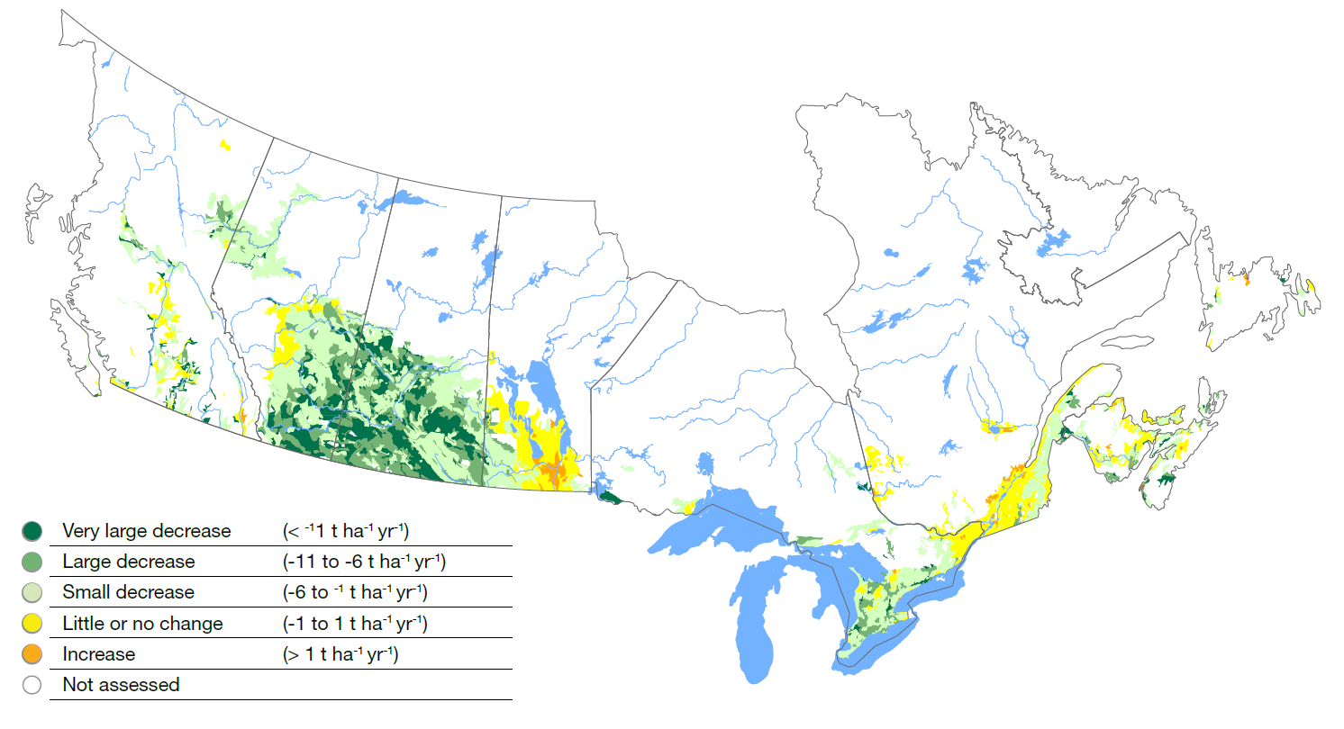
Soil Erosion Risk

Slide 22
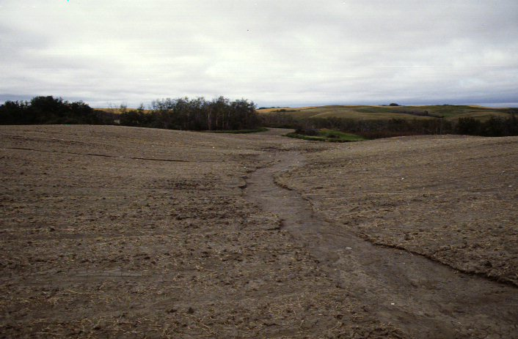
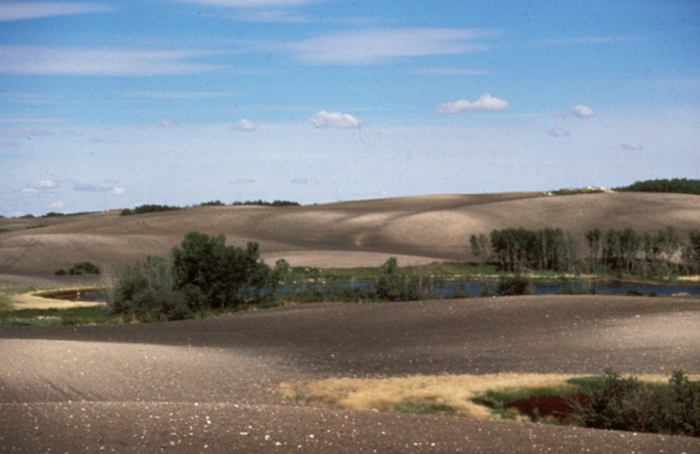
Controlling Erosion is Essential For Improving
Soil Health!

Slide 23
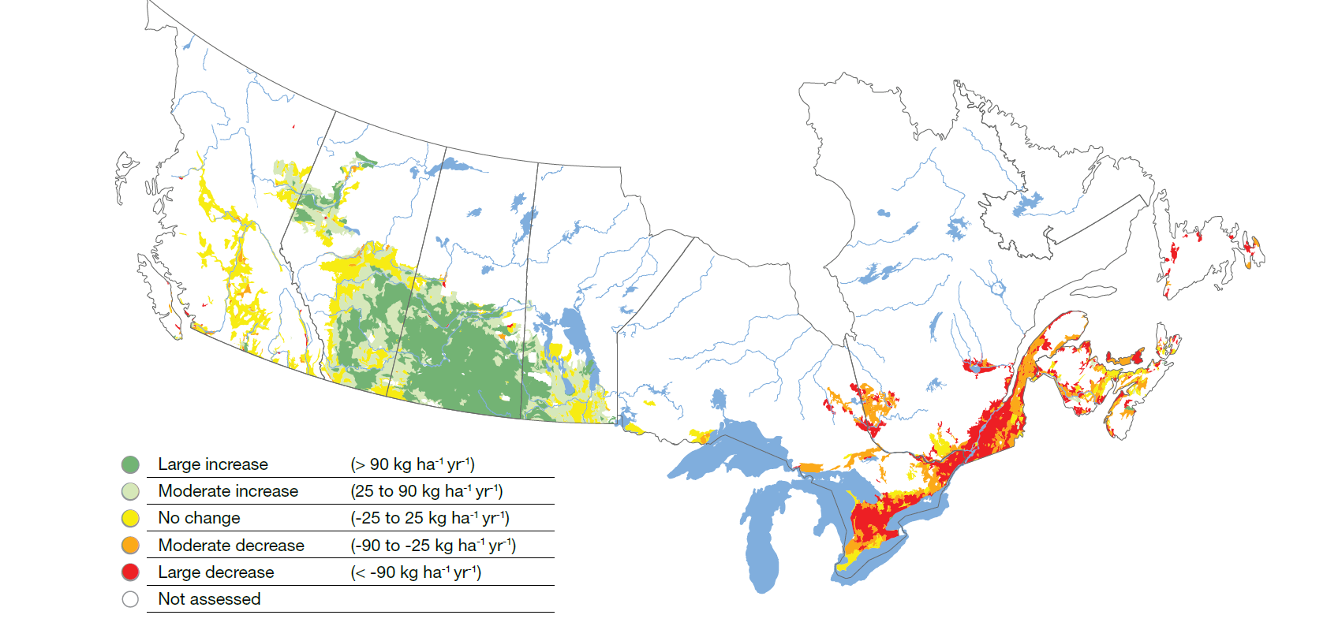
Soil Organic Carbon Loss and Gain

Slide 24
SOC change in context
Change from livestock based production with frequent perennials and manure to cash cropping will cause a drop in soil organic matter content
Loss of SOM does not necessarily produce an unhealthy soil state if bad stressors managed appropriately
  Serious erosion controlled
  High input of C to soil to have good soil organic matter quality (active portions like particulate OM)

Slide 25
Good Soil Stressors
Good Soil Health Stressors
Continual cover
Increase net organic C inputs
Control machinery traffic, rest from livestock, more roots
Add diversity of plants and critters on land
Soil amour (cover crops, perennials, deep rooted plants)
Amendments (lime, deficient micro and macro nutrients)

Slide 26
Soil Health Promoters
(Helpful Stressors)
Good Health Stressors
Continual cover
Increase net organic C inputs
Control machinery traffic, rest from livestock, more roots
Add diversity of plants and critters on land
Soil amour (cover crops, perennials, deep rooted plants)
Amendments (lime, deficient micro and macro nutrients)
Bad Health Stressors
Erosion
SOM decline
Compaction
Biodiversity loss
Contamination
Sealing
Salinization
Extreme events
Acidification

Slide 27
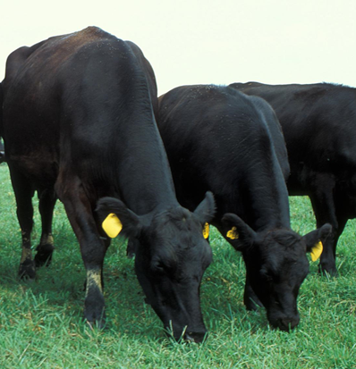
“Regenerative Agriculture” Has Many Principles for Building Soil Health
Minimum disturbance
Soil armour
  Continual protective cover
Diversity
Increase living roots
  Perennials, cover crops
Integrated livestock

Slide 28

Resilience
Resilience is different than soil health
Resilience is the amount of disturbance that an ecosystem can withstand without changing it systematic functions (self-organized processes and structures, stable states)

Slide 29
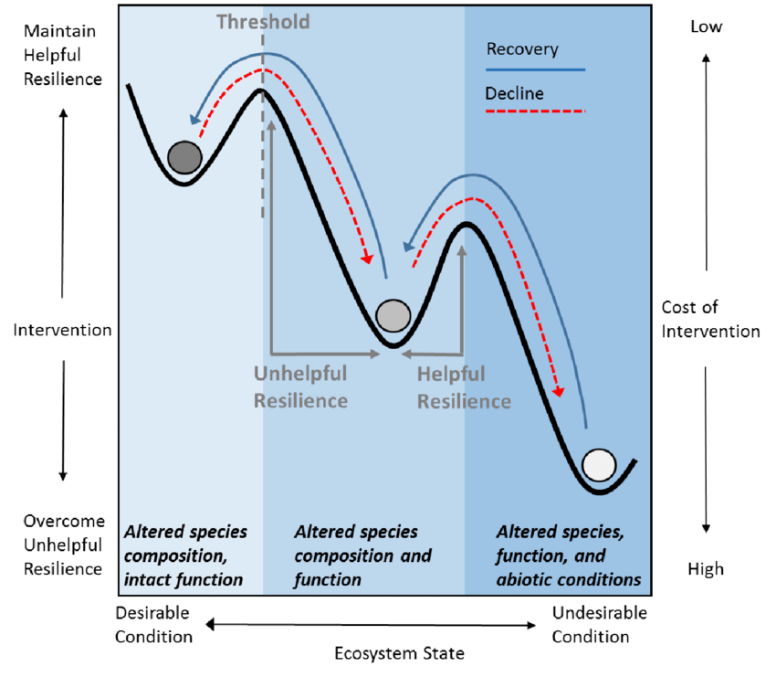
Adapted from: Ralston and Sarr, 2017, USGS

Slide 30
Summary
Soil health is soil-based functions that enable reaching productivity potential while supplying other desired ecosystem services (e.g. water quantity and quantity, climate regulation)
Because it is a holistic property, soil health state has to be assessed based on ecosystem services feasible in the local context
  Need to consider those characteristics that can be changed by management and those that are inherent (soil type, climate, weather) that can not be easily changed
There are many enemies (bad soil health stressors) of soil health
  Overall, erosion is the often the most important enemy
We can overcome enemies of soil health by minimizing them and counteracting them by adopting good soil health stressors
Regenerative agriculture’s plant-centric perspective of building soil health is useful
  How do we do a better job at capturing more of available solar energy by plants and using it to strengthen soil health

Slide 31


















Some of Our Clients / Partners
Help our clients in strategically navigating the complex and evolving world of sustainability
Experts in developing science-based metrics and solutions to enhance social license and public trust

Slide 32
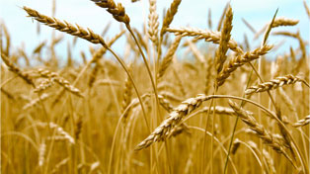
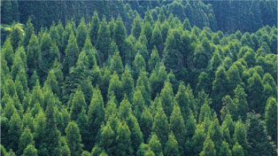

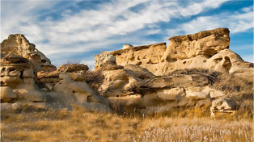

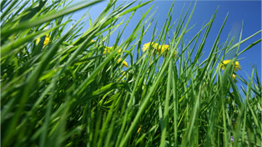
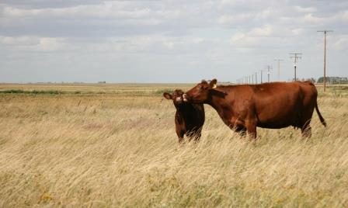

Core Business Areas
LOW CARBON STRATEGIES IN AGRICULTURE AND AGRI-FOOD SUPPLY CHAINS
FINANCING SUSTAINABILITY
CARBON INSETTING IN SUPPLY CHAINS
SUSTAINABLE SUPPLY CHAINS
PROTOCOL DEVELOPMENT
POLICY RESEARCH AND ANALYSIS
GREENHOUSE GAS QUANTIFICATION
INTERNATIONAL DEVELOPMENT

