Slide 1
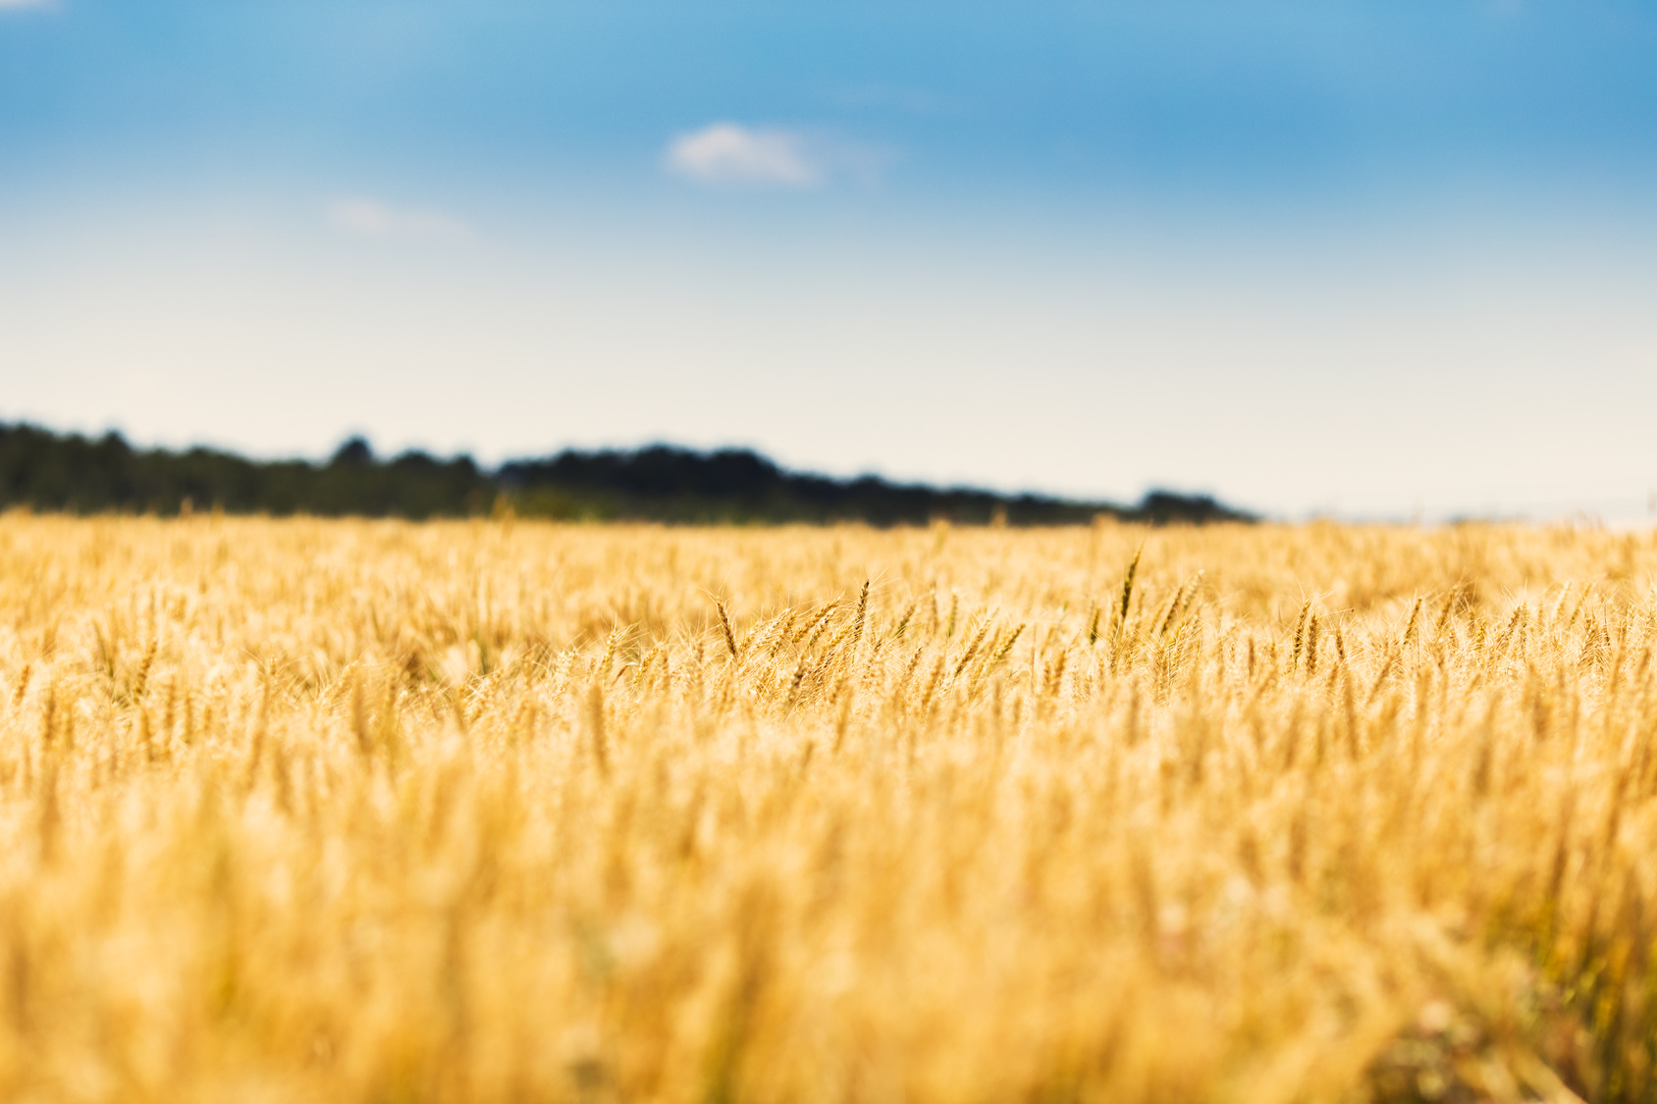
SOIL
SUSTAINABILITY
Cam Dahl, President
Soil Summit, October 2, 2019

Slide 2
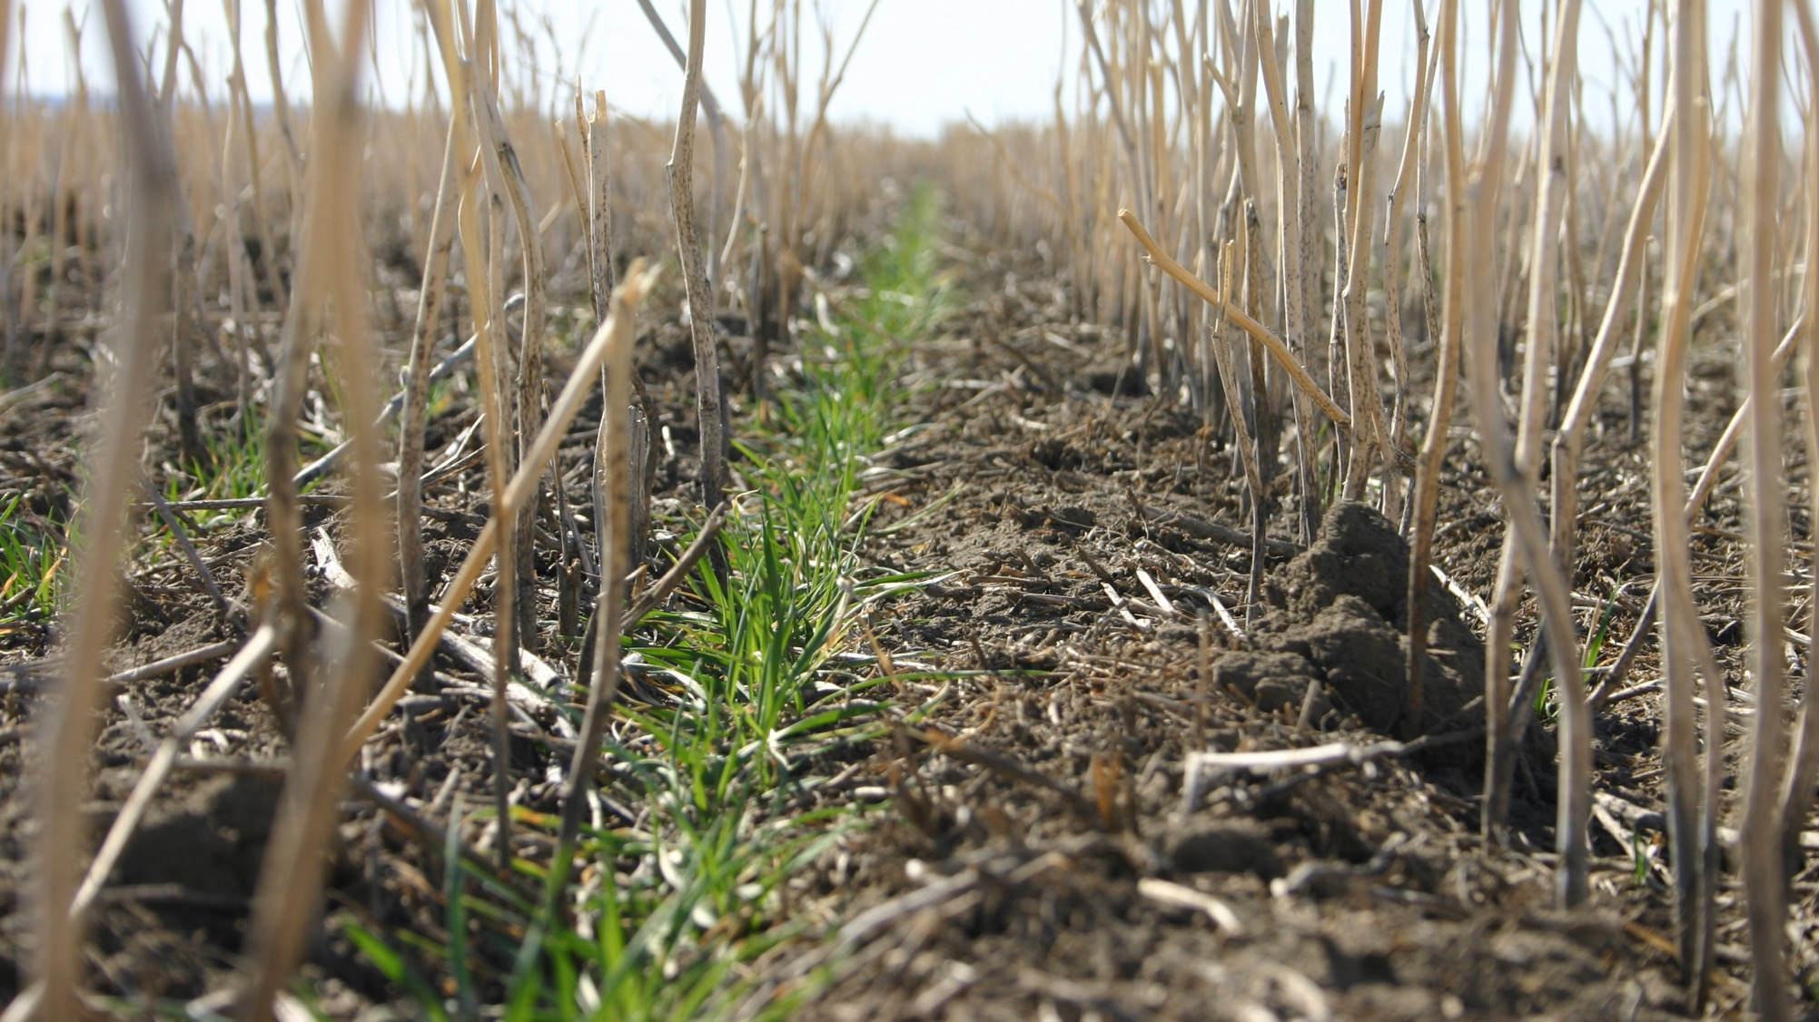
How does soil conservation fit into sustainable agriculture?
Notes:
Soil is the basis of everything in agriculture and food production. Healthy soils are the foundation to sustainable production systems.
Sustainable agriculture is dependent on healthy soils.
There is some good news of progress on this front, but there is still work that needs to be done.

Slide 3
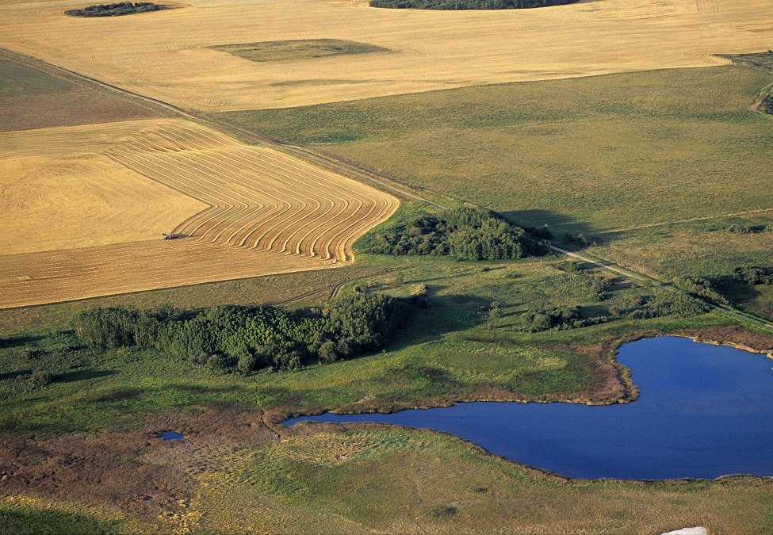
Soil Carbon
Clean water
Clean air
Biodiversity
Notes:
Healthy soil has tremendous value:
Storing carbon
Filtering air and water
Biodiversity – especially below ground, which is as, if not more, important as those that rely on it above ground

Slide 4
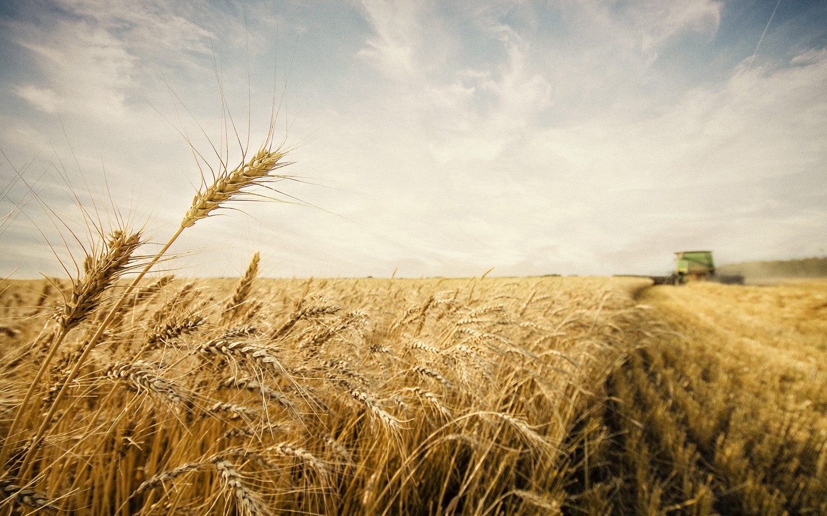
Soil Organic Matter
Reducing Erosion
Notes:
I want to focus for a few moments on two key elements of healthy soil – soils organic matter and resistance to erosion. These are two areas where agriculture has made progress in recent years.

Slide 5
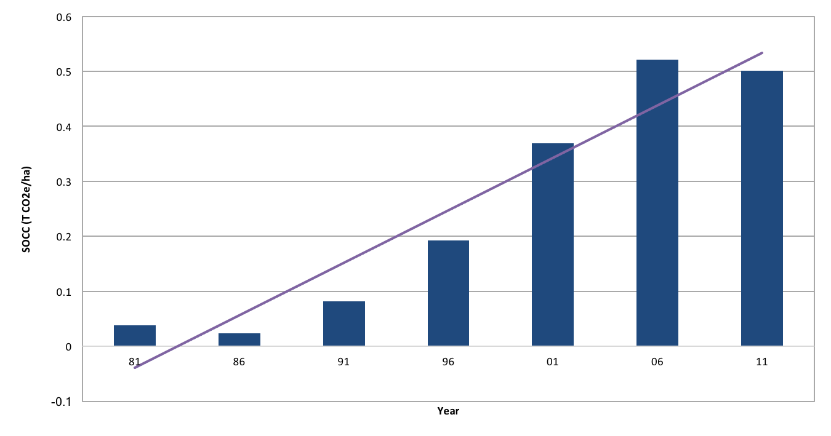
Soil Organic Carbon Change per Hectare of Agricultural Land, Prairies
Notes:
Soil organic matter is on important measure of soil health.
This chart shows how the organic matter on the prairies is changing over time. Back in 1981, soil organic matter was being depleted. But modern agriculture – including new pant breeding techniques, precision agriculture, conservation tillage– has changed this picture dramatically. Organic matter in prairie soils is increasing every year.
What does this mean? Well it means Canadian soil is healthier today than it was in 1981. It is more productive, it is less susceptible to wind and soil erosion and is sequestering more and more carbon dioxide every year.
As an aside, you will note that this data series ends in 2011. We are anxiously waiting for the updates to the agro-ecology data set from the Government of Canada. If there is anyone in the room from Agriculture and Agri-Food Canada, please forward on this request. We cannot tell the story of Canadian agriculture’s sustainability without the data.

Slide 6
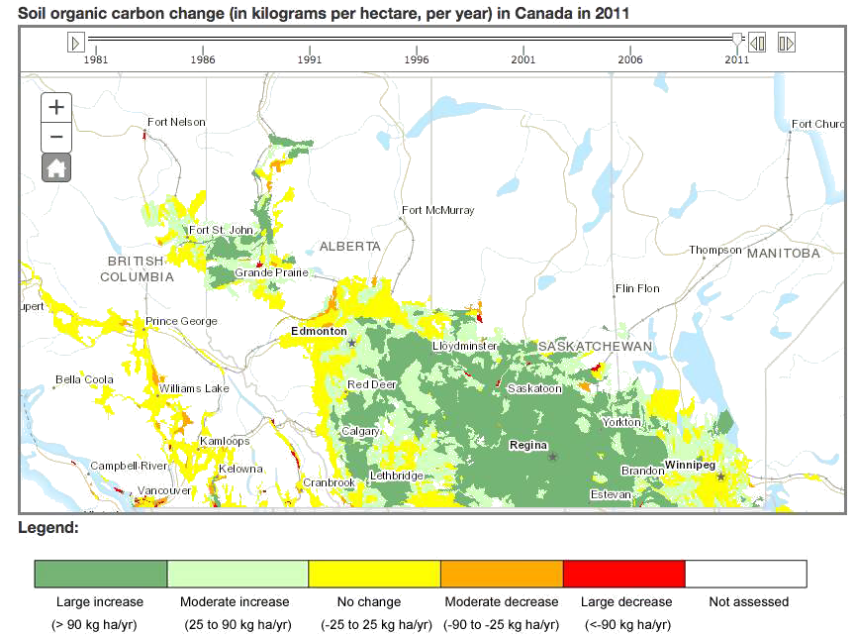
Soil Organic Carbon Change
Source: Agriculture and Agri-Food Canada
Notes:
This is a map of the prairie growing region, showing the increases in organic matter each year. All of the green regions are showing significant increases in organic matter each year.
All of that organic matter is also sequestered carbon, demonstrating another way modern Canadian agriculture is helping reduce greenhouse gasses.

Slide 7
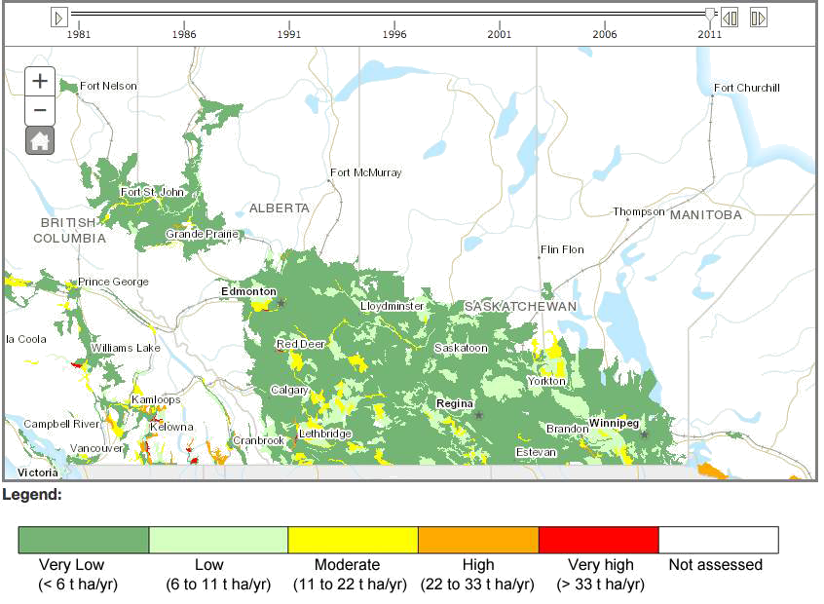
Reducing Soil Erosion
Source: Agriculture and Agri-Food Canada
Notes:
Reducing wind and water soil erosion is another measure of sustainability.
This map shows the very low incidence of soil erosion across the prairie growing region.
This picture was not always this way. The adoption of modern agricultural practices such as conservation tillage has meant that Canadian farmers are leading the way in the world regarding soil erosion losses. Farmers are changing their agronomic practices because it makes good business sense. Modern agriculture practices drive down costs per tonne of grain produced and increase the potential for profitability. This is a good example of where environmentally sustainable practices are also economically sustainable in the long run.

Slide 8
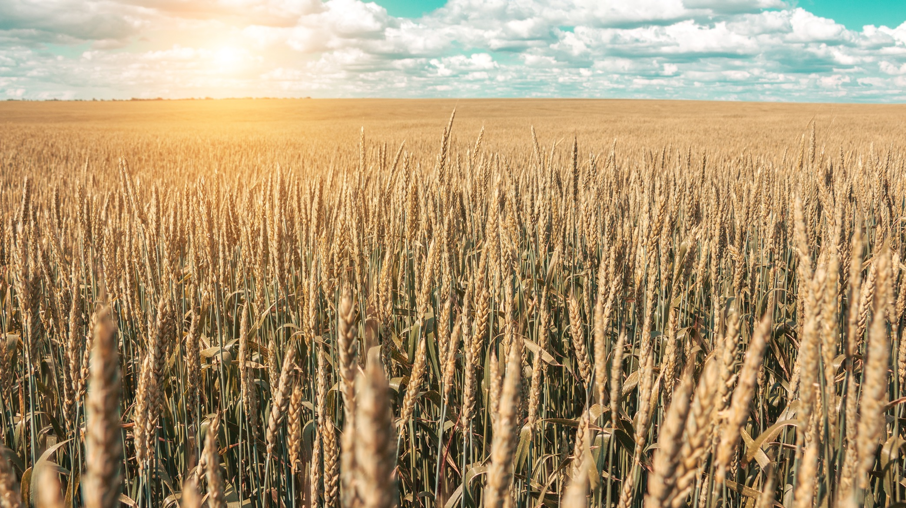
There is still work to be done
Notes:
While modern agricultural practices - such as conservation tillage, precision agriculture, growing use of cover crops – has resulted in improvements to soil health, there is still work to be done. We need to get the message out that the agronomic practices that are good for soils health are also good for the economic well being of the farm.

Slide 9
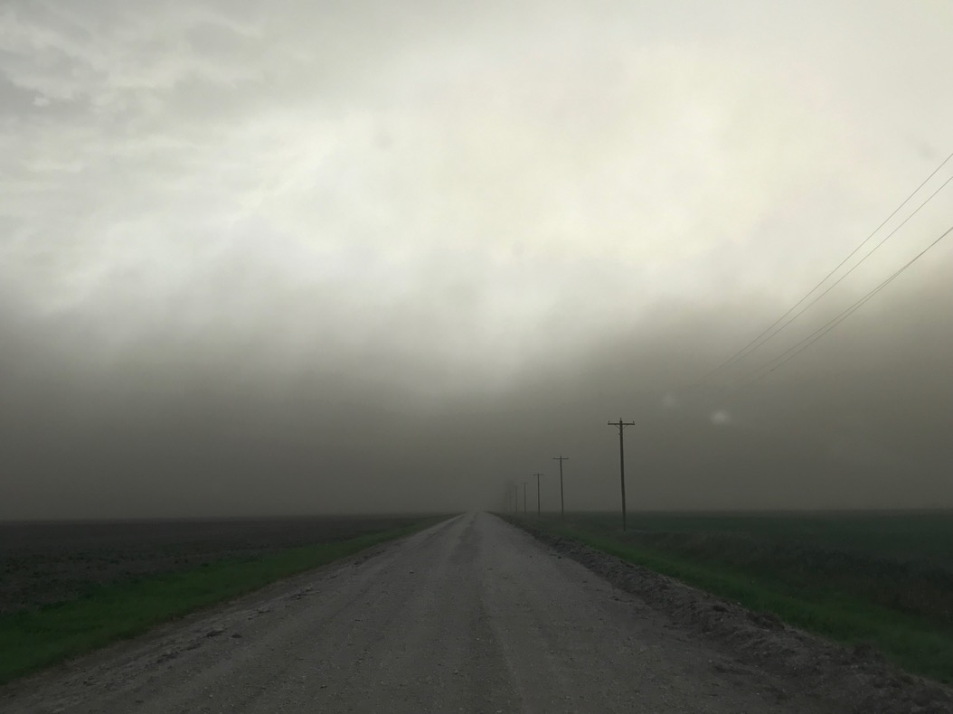
The answer is not blowing in the wind
Manitoba, June 2019
Notes:
No, this isn’t a photo from the Great Depression era of the 1930’s. This was taken this past June.
The answer is not blowing in the wind. In fact, this is bad for agriculture. It is bad for the economic health of farms. And this is bad for our industry’s reputation. How do we ensure that pictures like that are permanently relegated to history books?

Slide 10
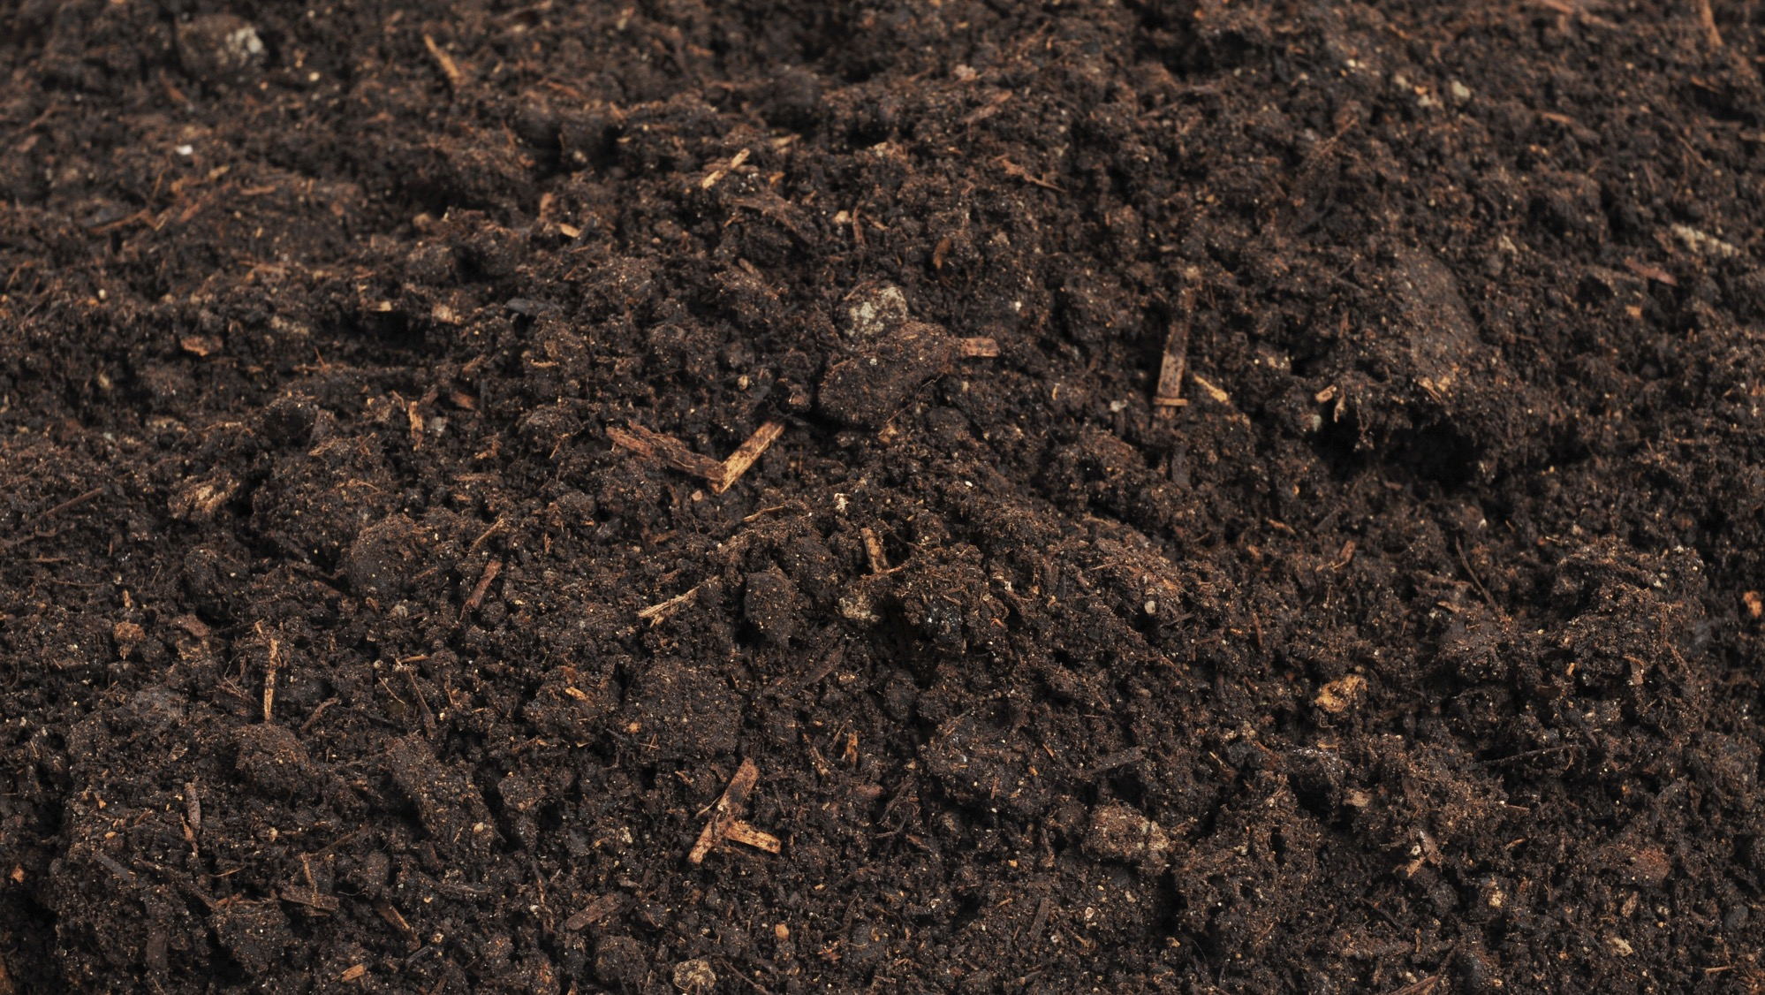
Soil health must be part of our focus.
Notes:
When it comes to talking about sustainable agriculture we need to focus on the things that matter for the long run health of the air, water and land. This focus must include soil health as part of the solution to sustainably produced food. We need to treat soil as the important resource it is.
We need to weave soil into everything we do as an industry. From our national organizations like Cereals Canada to independent field agronomists, we all need to include soil conservation messaging and practices into our everyday work and outreach activities.

Slide 11
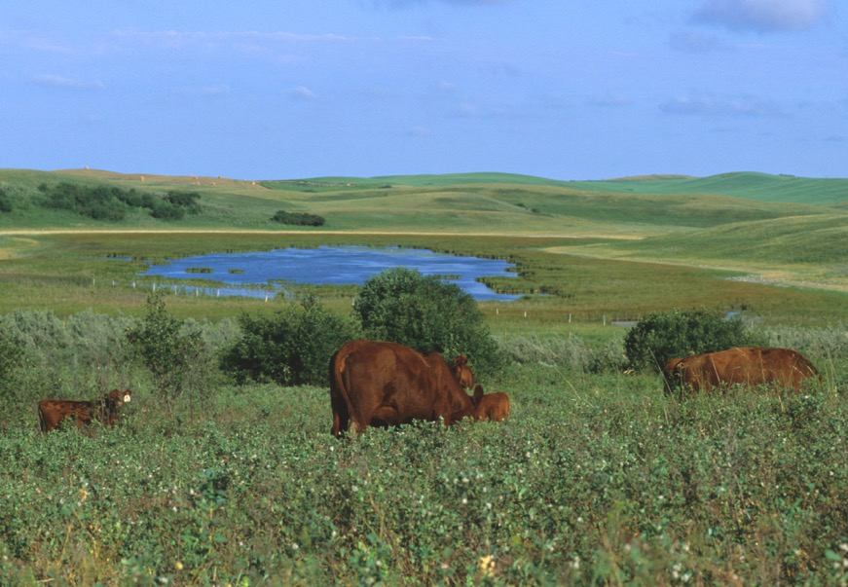
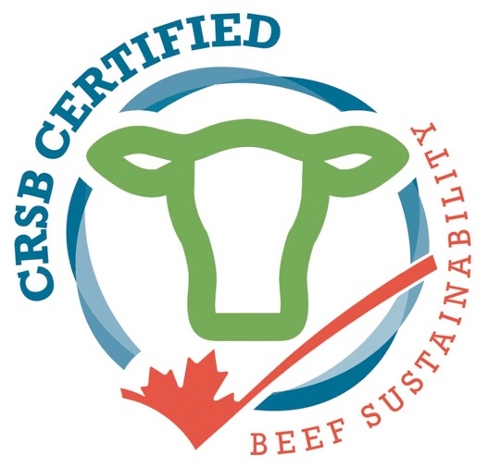
Notes:
The Canadian Roundtable for Sustainable Beef and its sustainability framework are proof there is an appetite for the industry to unite as a whole for the betterment of Canadians farmers and the way they produce food. The beef industry’s efforts have also demonstrated that this approach works.
Through a voluntary framework or code of practice, we can not only tell, but show Canadians that we are doing the right things and are continually striving to be better.

Slide 12
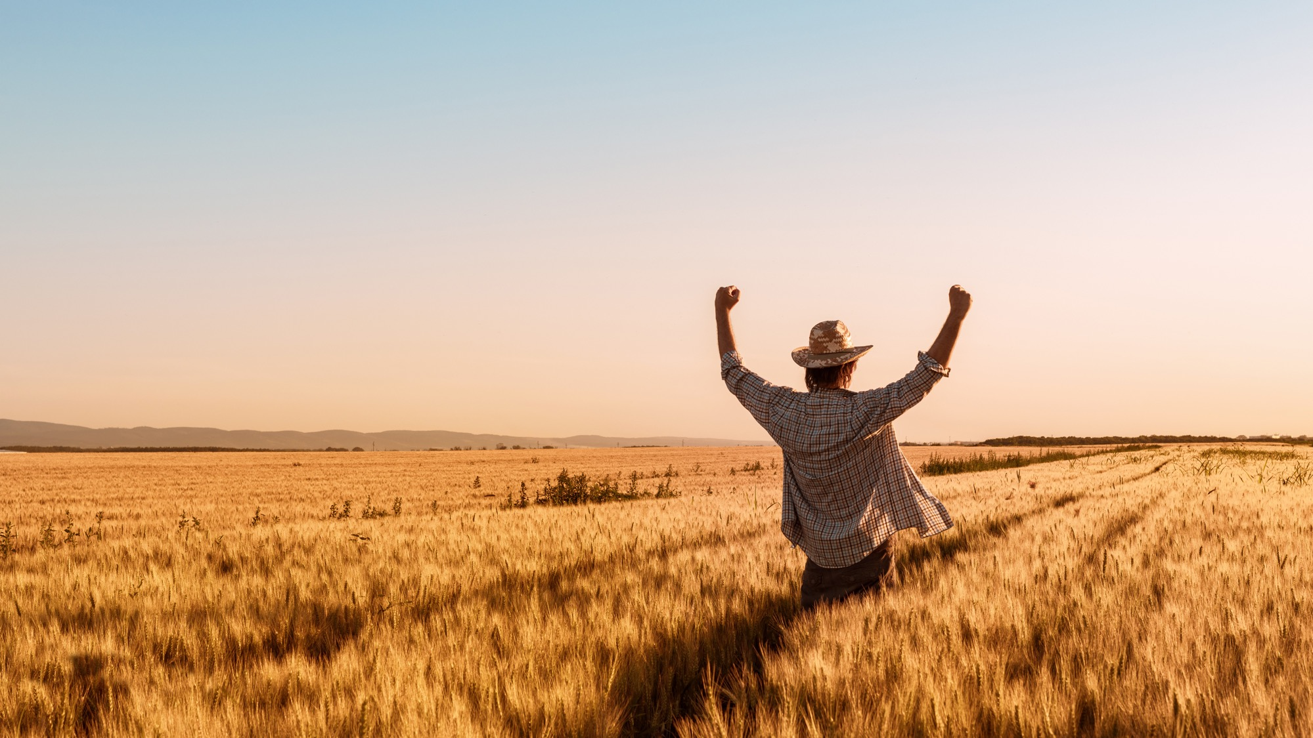


Code of Practice
For grain, oilseed and special crop production
Notes:
The Canadian Round Table for Sustainable Crops has begun the development of a Code of Practice for the production of grains, oilseeds and special crops production I Canada. While still in the early stages, significant progress has been made. The Code Development Committee has been struck and is Chaired by the Hon. Ted Menzies.
The Code is the cornerstone of the Public Trust Strategy developed by the Grains Roundtable Public Trust Working Group.
The Grains Roundtable requested the Canadian Roundtable for Sustainable Crops to develop a Code of Practice for the cereals, oilseeds and special crops sectors.
In my mind there are three primary objectives for the Code:
Public Trust - Help communicate to the public on the work being done by modern agriculture to ensure the long run sustainability of modern agriculture
Help communicate to farmers the best management practices that will ensure long run sustainability, both environmentally and economically
Help ensure ongoing international market access for Canadian grains, oilseed and special crops.
Protecting and enhancing soil health will be a key component of the Code of Practice. Our success as an industry in improving soil health will be one of the key components of the messages we will deliver to our customers and consumers.

Slide 13
What is a grains, oilseeds and special crops Code of Practice?
List of best practice for the production of grains, oilseeds and special crops in Canada
Based on concept and process used by National Farm Animal Care Council
Will include “required” and “recommended”
Focused on practices that are of most importance to public trust/ national and international markets
Adherence to be measured on aggregate basis through credible data sources
Expected to be of value in demonstrating concern for issues that impact Canadians/internal markets, and mechanism for communicating Canadian performance on the practices covered through the Code

Slide 14
Code of Practice Primary Principles
Farmers must be directly involved in the development of the Code of Practice as members of the Code Development Committee.
Representation on the Code Development Committee will be both nationally and regionally balanced and include scientific expertise, non-governmental organizations with interest in sustainability and customers / processors (in addition to farmers).
Code practices will use best available, most recent science/studies from accepted sources
The developed Code of Practice will be voluntary.
Code practices will be defensible through sound science.
Code practices should be practical, manageable and consider economic implications.

Slide 15
Code Committee Structure
(5) farmers
-regionally balanced -farmers would be “whole farm”, not considered representative of one commodity or value chain
- efforts made to have, within the group, farmers who grow cereals, oilseeds and special crops
(1) Exporter
(1) Processor (e.g., miller, crusher)
(1) Input supplier
(1) Food processor, retail or food service company
(2) non-governmental organizations with interest in sustainability
(1) university or government academics/researchers
(1) government (federal)

Slide 16
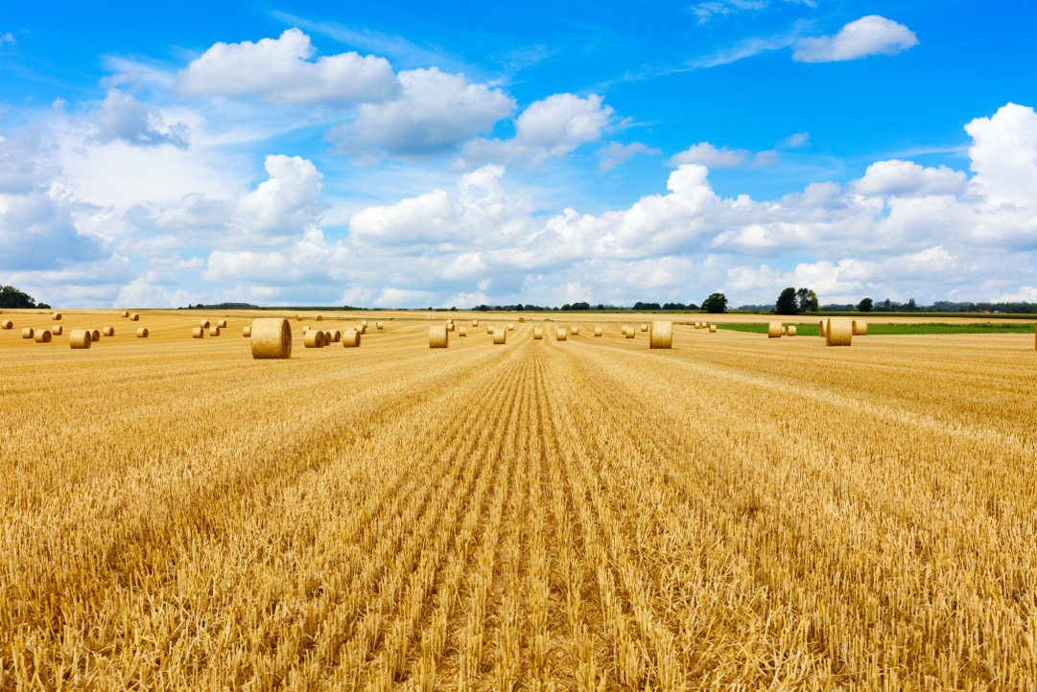
Good farmers steward their soil
Notes:
Soil conservation and health is a key part of agriculture sustainability. We want the public to know that good farmers steward their soil, and we do have a good story to tell. However, when it comes to sustainability, there is no end game. Sustainability is constantly exercising and flexing our muscles to be better tomorrow than we are today.
Good farming means improving soil health. The Code of Practice will be a key tool in communicating best management practices to farmers to ensure we have continuous improvement in protecting against erosion and securing this important resource for future generations.

Slide 17
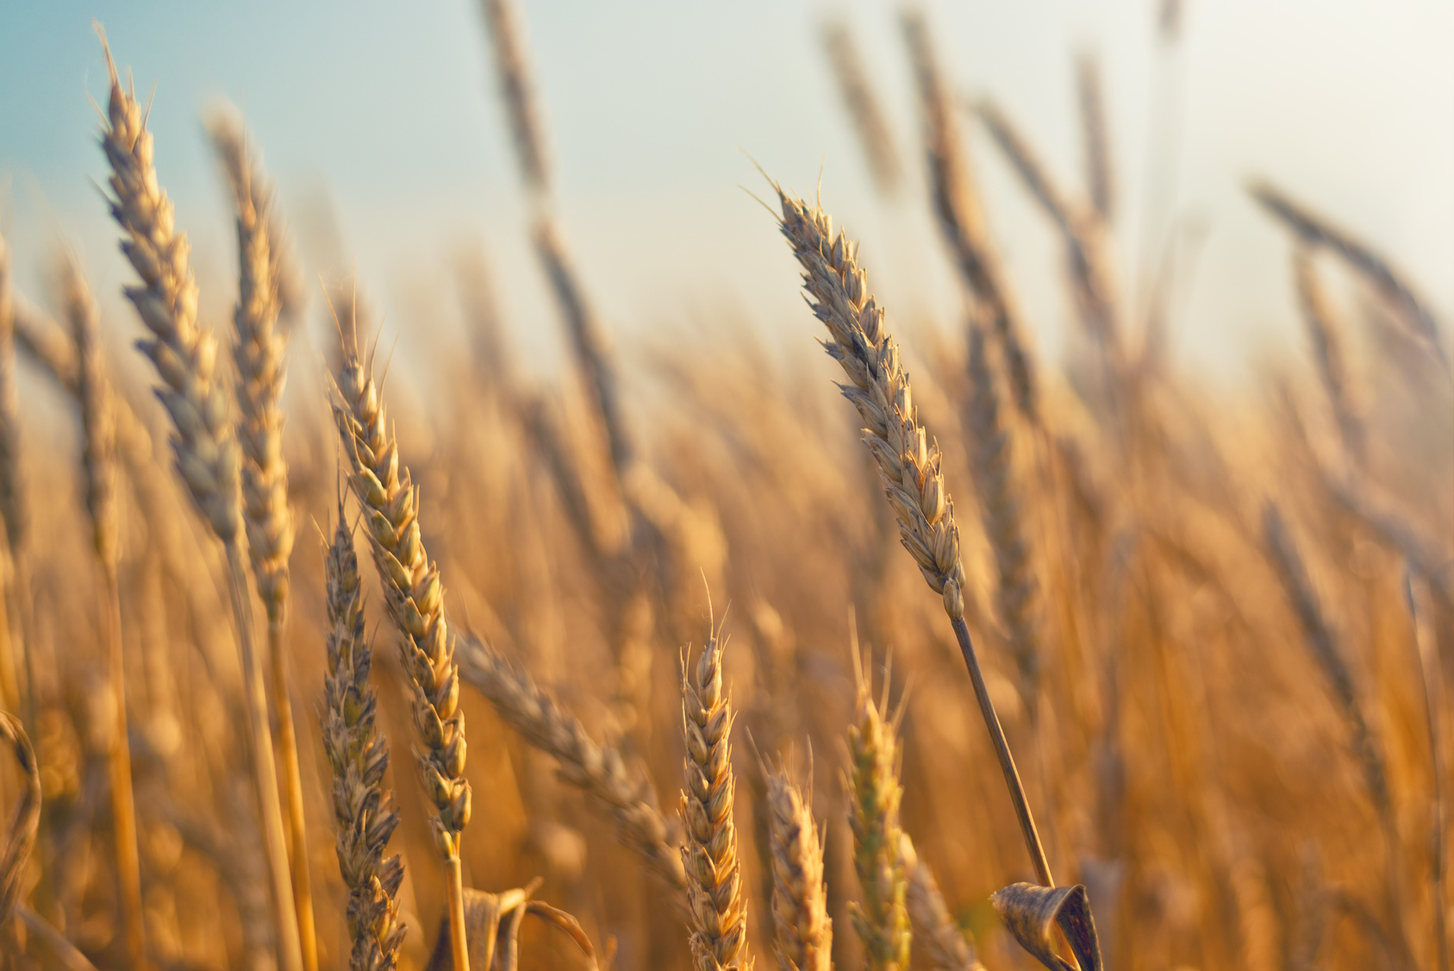
A dynamic, responsive Canadian cereals industry that brings sustainable profitability to the entire value chain.
Room 670, 167 Lombard Avenue
Winnipeg, Manitoba R3B 0V3
PHONE
EMAIL
WEBSITE
TWITTER
204.942.2166
info@CerealsCanada.ca
CerealsCanada.ca
Cereals_Canada

