Slide 1
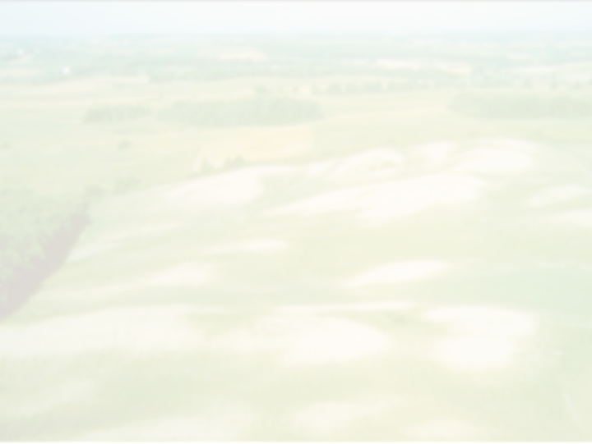

State of Canadian Soil Health in 2019: A Report Card
David A. Lobb
Department of Soil Science
University of Manitoba
Summit on Canadian Soil Health 2019
Soil Conservation Council of Canada
October 2nd, 2019
Oak Hammock Marsh, Stonewall, Manitoba
Notes:
I would like to thank the Soil Conservation Council of Canada for inviting me to participate in this summit.

Slide 2
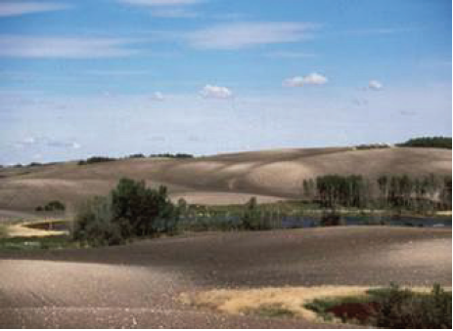
Soil Degradation:
The Cost to Agriculture and the Economy
David A. Lobb
Nasem Badreldin
Marita Loro
Department of Soil Science
University of Manitoba
Sheng Li
Brian G. McConkey
Agriculture and Agri-Food Canada
Summit on Canadian Soil Health
Soil Conservation Council of Canada
August 23rd, 2017
Guelph, Ontario
Notes:
I presented at the first in this series of summits back in 2017.
At that meeting, I reported on the state of soil erosion across Canada at that time based on our early research.

Slide 3
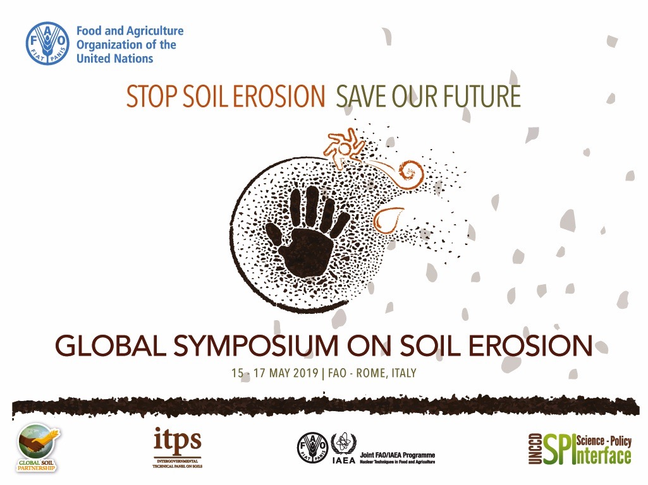
Notes:
We have continued our research on the assessments of soil erosion and its economic impact.
This work was most recently presented in two parts at the UN-FAO Global Soil Erosion Symposium in May 2019.

Slide 4
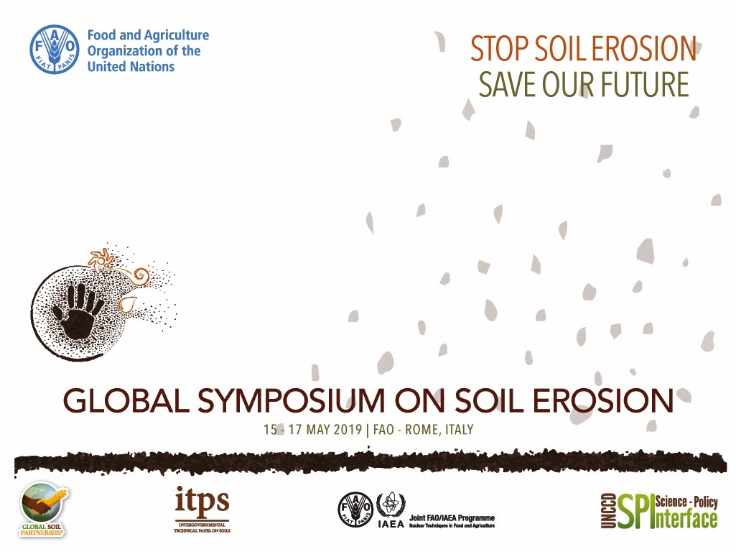
National Assessment of Soil Erosion in Canada
from 1971 to 2016
David Lobb¹, Sheng Li², Brian McConkey², Nasem Badreldin^{1,3}
¹University of Manitoba,²Agriculture and Agri-Food Canada, ³University of Guelph
Notes:
The first…The assessment of the soil erosion…

Slide 5
Assessment of the Cost of Soil Erosion to Crop Production in Canada
Nasem Badreldin^{1,2}, David Lobb¹
¹University of Manitoba, ²University of Guelph
Notes:
And the second…The assessment of the cost…
The results and findings of these assessments are presented in brief here today, but are available in detail.

Slide 6
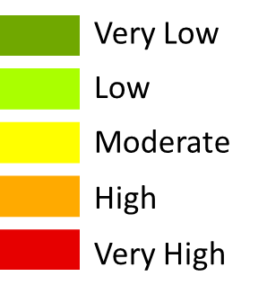
Assessment of Soil Erosion
Distribution of Soil Loss Rates for 1971 and 2011: Soil Erosion
1971
Soil Erosion Risk Classes
2011
Notes:
The assessment of soil erosion is the separate and combined effects of wind, water and tillage erosion.
The current assessment extends from 1971 to 2011.
Illustrated are the annual soil losses on the eroding portion (upper and mid slope segments) of the cultivated landforms in each Soil Landscapes of Canada polygon.

Slide 7
Assessment of Cost
Annual Soil Loss and Crop Yield Loss in 1971 and 2011
 |  |  | 1971 |  |  |  | 2011
 |  | Units | Low-Eroding Cropland (N-L) | High-Eroding Cropland (M-VH) | Total |  | Low-Eroding Cropland (N-L) | High-Eroding Cropland (M-VH) | Total
 | Cropland Area | ha | 25,149,351 | 14,663,025 | 39,812,376 |  | 35,211,104 | 3,676,329 | 38,887,434
 |  | % | 63.2 | 36.8 | 100 |  | 90.5 | 9.5 | 100
 | Soil Loss Rate | t ha⁻¹ yr⁻¹ | 5.9 | 24.0 |  |  | 3.5 | 22.7
 | Relative Crop Yield | % | 99.5 | 83 |  |  | 95 | 40
 | Crop Yield Loss | % | 0.5 | 17 |  |  | 5 | 60
* no net improvement *
Notes:
Shifts in High Eroding Cropland Areas and Crop Yields. Great improvements in soil conservation as indicated by a decrease in the area of crops on moderately to severely eroding land between 1971 and 2011, and an increase in the area on land subject to low to negligible levels of soil erosion.
These soil erosion levels are average annual rates. They do not reflect the cumulative amount of soil loss on a piece of land. Cumulative soil loss over many years prior to 1971 and through to 2011 is reflected in the SOC levels of the soil and ultimately the Crop Yield and Crop Yield Loss.

Slide 8
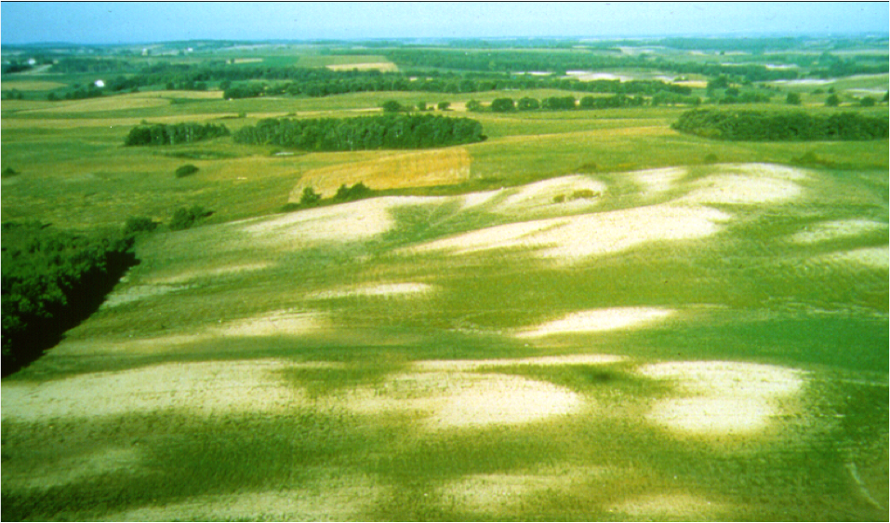
Assessment of Cost
Soil Loss and Yield Loss Relationship:
1 x DTS
2 x DTS
Crop yield (%)
* non-linear response
Amount of original topsoil remaining (%SOC)
Result of cumulative soil loss over many years
Notes:
To carryout the economic analysis it is necessary to translate the loss of productive topsoil into a loss of crop production. The economic analysis is very sensitive to this information -- it is a critical element of such analysis.
Crop productivity is expressed relative to potential crop yield on non-eroded site.
Loss of Crop Yield driven by the loss of original organic-rich topsoil, indicated by the decline in depth of the topsoil (DT, equivalent to the original topsoil depth in terms of SOC) and SOC.
Topsoil is lost through soil erosion, and diluted through incorporation of subsoil by tillage.
* It is assumed that there are only modest gains through OC inputs from crops and crop residue – very little potential for gain OC on moderately to severely eroded soils where productivity is inherently low due to hydrology.

Slide 9
Assessment of Cost
Annual Soil Loss and Crop Yield Loss in 1971 and 2011
 |  |  | 1971 |  |  |  | 2011
 |  | Units | Low-Eroding Cropland (N-L) | High-Eroding Cropland (M-VH) | Total |  | Low-Eroding Cropland (N-L) | High-Eroding Cropland (M-VH) | Total
 | Cropland Area | ha | 25,149,351 | 14,663,025 | 39,812,376 |  | 35,211,104 | 3,676,329 | 38,887,434
 |  | % | 63.2 | 36.8 | 100 |  | 90.5 | 9.5 | 100
 | Soil Loss Rate | t ha⁻¹ yr⁻¹ | 5.9 | 24.0 |  |  | 3.5 | 22.7
 | Relative Crop Yield | % | 99.5 | 83 |  |  | 95 | 40
 | Crop Yield Loss | % | 0.5 | 17 |  |  | 5 | 60
* little or no net improvement *
Notes:
Accounting for the cumulative soil losses, there appears to be little net improvement.
17% Crop Yield Loss on 37% of the cropped area (a product of 6.3) is about the same impact as at 60% Crop Yield Loss on 10% of the cropped area (a product of 5.7).

Slide 10
Assessment of Cost
… and Lost Value
 |  |  | 1971 |  |  |  | 2011
 |  | Units | Low-Eroding Cropland (N-L) | High-Eroding Cropland (M-VH) | Total |  | Low-Eroding Cropland (N-L) | High-Eroding Cropland (M-VH) | Total
 | Cropland Area | ha | 25,149,351 | 14,663,025 | 39,812,376 |  | 35,211,104 | 3,676,329 | 38,887,434
 |  | % | 63.2 | 36.8 | 100 |  | 90.5 | 9.5 | 100
 | Soil Loss Rate | t ha⁻¹ yr⁻¹ | 5.9 | 24.0 |  |  | 3.5 | 22.7
 | Relative Crop Yield | % | 99.5 | 83 |  |  | 95 | 40
 | Crop Yield Loss | % | 0.5 | 17 |  |  | 5 | 60
 | Degraded Value | $2016 |  |  | 13,570,289,116 |  |  |  | 27,326,006,316
 | Non-Degraded Value | $2016 |  |  | 14,525,640,873 |  |  |  | 30,429,706,921
 | Lost Value | $2016 |  |  | $0.96 B yr⁻¹ |  |  |  | $3.1B yr⁻¹
Cumulative loss up to 1971 in the order of $20-30B
Notes:
The Degraded Value of crop production is the reported market value of the crops grown in that year, expressed in 2016 dollars ($2016). The Non-Degraded Value is estimated value assuming that field-average yields could be met throughout the cropped area.
By using field-average values, it sort of accounts for the fact that crop yields on non-eroded upper slope positions are naturally lower and non-eroded lower slope positions are naturally higher due to soil moisture variations that naturally occur in hilly soil-landscapes.
The Lost Value in crop production due to cumulative soil losses in 1971 is estimated to be about $1B (7%) ($2016). The estimated cumulative Lost Value for the preceding 30 to 60 years, assuming a soil loss rate equivalent to 30x the 1971 rate, is $20-30B.
* The Lost Value in 1971 and 1981 is similar to Rennie’s $1.1B in the early 1980s. This estimate is as equally good, or bad as Rennie’s.

Slide 11
Assessment of Cost
… and Lost Value
 |  |  | 1971 |  |  |  | 2011
 |  | Units | Low-Eroding Cropland (N-L) | High-Eroding Cropland (M-VH) | Total |  | Low-Eroding Cropland (N-L) | High-Eroding Cropland (M-VH) | Total
 | Cropland Area | ha | 25,149,351 | 14,663,025 | 39,812,376 |  | 35,211,104 | 3,676,329 | 38,887,434
 |  | % | 63.2 | 36.8 | 100 |  | 90.5 | 9.5 | 100
 | Soil Loss Rate | t ha⁻¹ yr⁻¹ | 5.9 | 24.0 |  |  | 3.5 | 22.7
 | Relative Crop Yield | % | 99.5 | 83 |  |  | 95 | 40
 | Crop Yield Loss | % | 0.5 | 17 |  |  | 5 | 60
 | Degraded Value | $2016 |  |  | 13,570,289,116 |  |  |  | 27,326,006,316
 | Non-Degraded Value | $2016 |  |  | 14,525,640,873 |  |  |  | 30,429,706,921
 | Lost Value | $2016 |  |  | $0.96 B yr⁻¹ |  |  |  | $3.1B yr⁻¹
2x
Cumulative loss up to 1971 in the order of $20-30B
Cumulative loss from 1971 to 2011 in the order of $40-60B
Notes:
The value in crop production increased markedly from 1971 to 2011; consequently, the greater Crop Yield Loss on the smaller High-Eroding Cropland area, translates into a much greater Lost Value. The annual Lost Value has increased to $3B (10%) in 2011 ($2016), with an estimated cumulative Lost Value of $40-60B between 1971 and 2011. The annual Lost Value is expected to be similar in 2016 and the cumulative value continuing to grow.
These numbers are rough, but they are the best we have. They are considered to be very conservative. And they do not include any indirect costs either on site or off-site.

Slide 12

Assessment of Cost
Why has the cost of soil erosion continued to increase since the 1970s and 1980s, rather than decrease???
The value of crop production has increased. Farmers are growing higher yielding, higher value crops on land that is eroded.
Notes:
The obvious question is why has the cost of soil erosion continued to increase, in spite of the widespread adoption of soil conservation practices.
The value of crop production has increased over the past 30 or 40 years. It appears that farmers are growing higher yielding and higher value crops on land that is eroded.

Slide 13
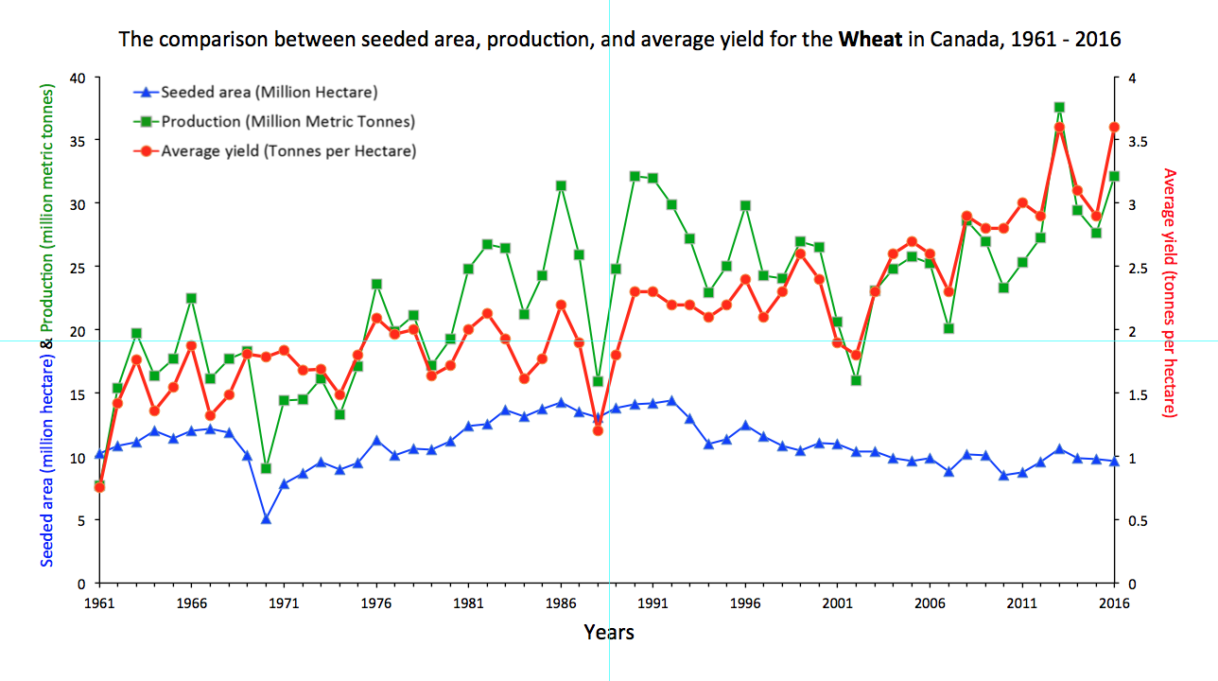
Assessment of Cost
Seeded Area, Production and Yield for Wheat in Canada, 1961-2016
Seeded Area (M ha) & Production (M t)
Crop Yield (t/ha)
Notes:
Farmers are growing higher yielding crops on eroded land.
Doubling crop yield, doubles the cost of a 10% yield loss.

Slide 14
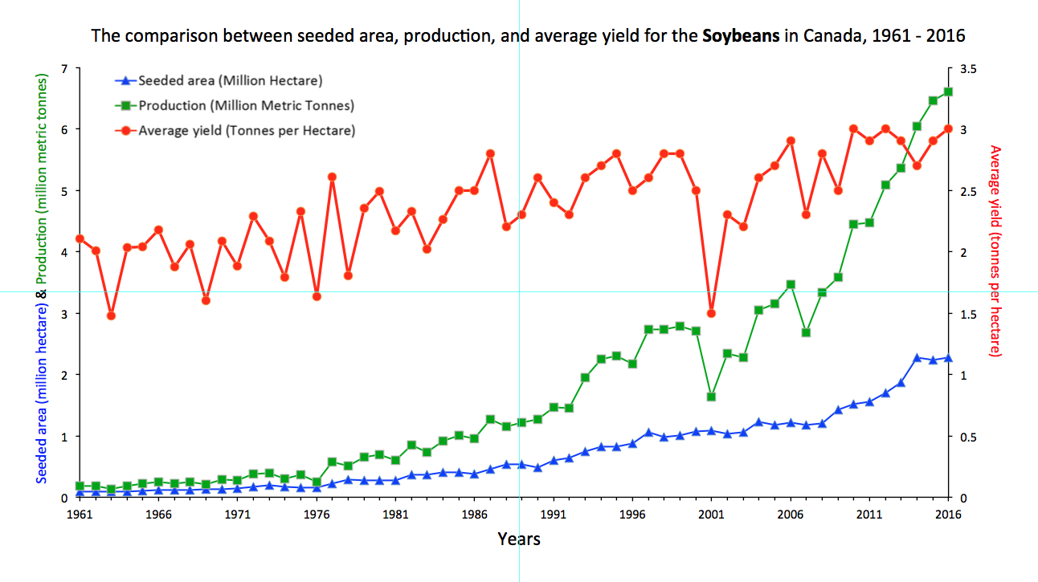
Assessment of Cost
Seeded Area, Production and Yield for Soybeans in Canada, 1961-2016
Seeded Area (M ha) & Production (M t)
Crop Yield (t/ha)
Notes:
Farmers are growing higher value crops on land that is eroded.
With higher value crops, the cost of a 10% yield loss is higher.
It is important to remember
When profit margins are slim in crop production, that 10% yield loss can represent a much larger % of the potential profit.

Slide 15
Conclusions
Tillage erosion is a major cause for moderate to high rates of soil erosion, and should be the focus of soil conservation efforts.
  Conservation tillage must focus on the amount of soil movement during tillage as well as the amount of crop residue left on the soil surface.
Notes:
Tillage erosion is a major cause for moderate to high rates of soil erosion, and should be the focus of future soil conservation efforts.
Conservation tillage must focus on the amount of soil movement during tillage as well as the amount of crop residue left on the soil surface.

Slide 16
Conclusions
An integrated approach to managing all forms of soil erosion is necessary to minimize soil loss and restore eroded soils.
  This can be challenging. Some soil conservation practices will reduce one form of erosion while exacerbating another form. In particular, tillage practices that are effective in reducing wind and water erosion are not necessarily effective against tillage erosion. For example: the chisel plough leaves more crop residues on the soil surface than the moldboard plough, providing more protection against wind and water. At the same time, the chisel plough can move soil over a much greater distance and cause more tillage erosion.
Notes:
An integrated approach to managing all forms of soil erosion is necessary to minimize soil loss and restore eroded soils.

Slide 17
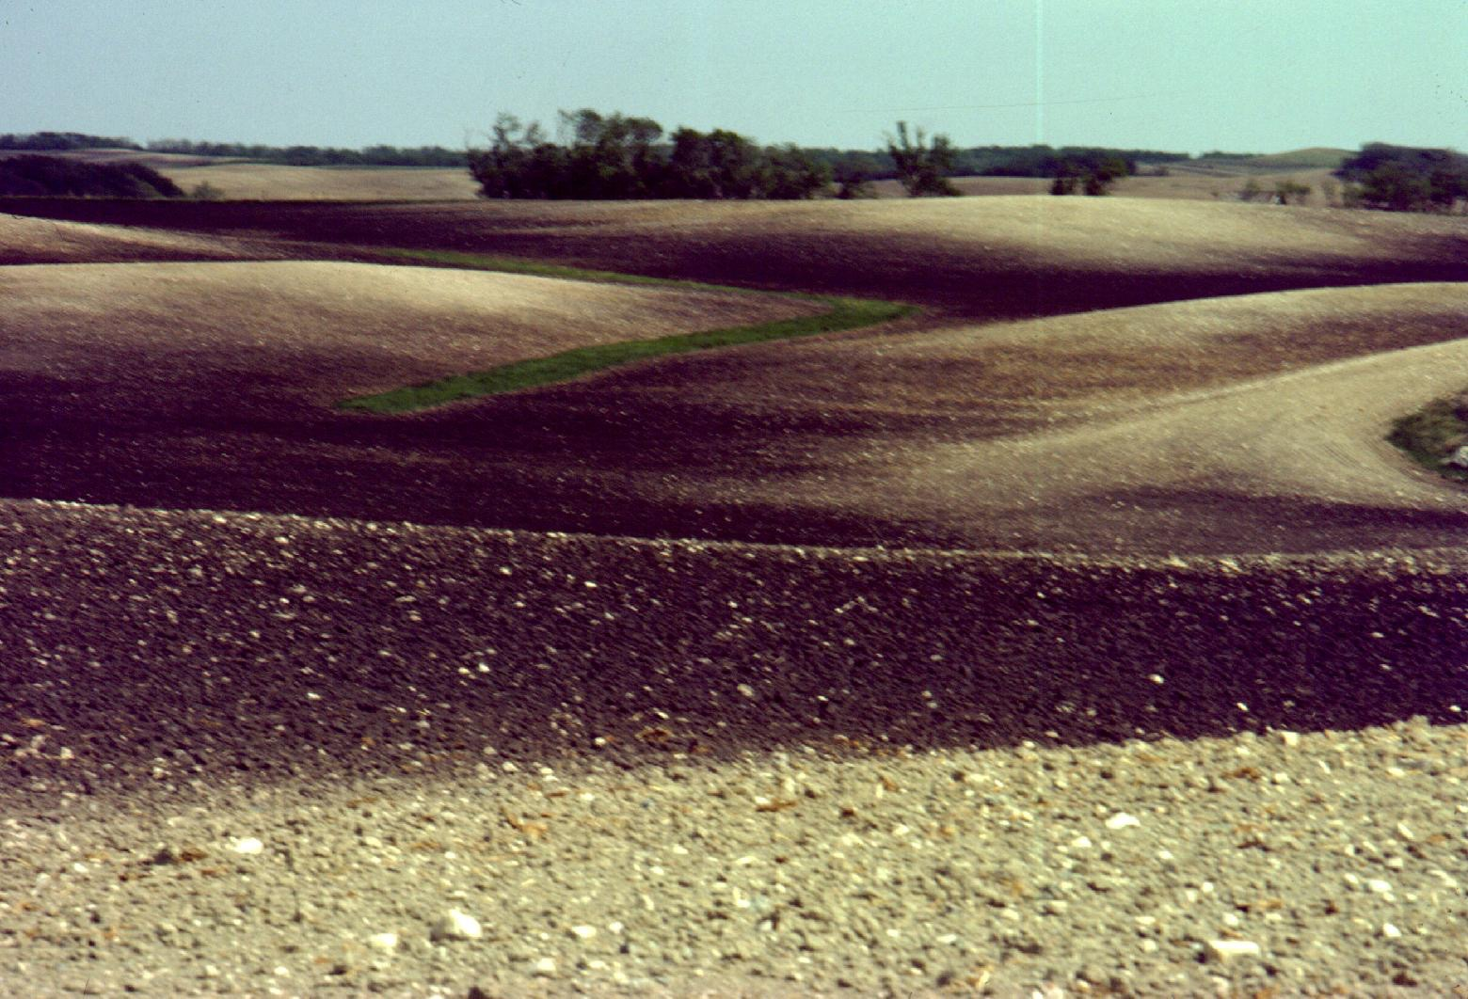
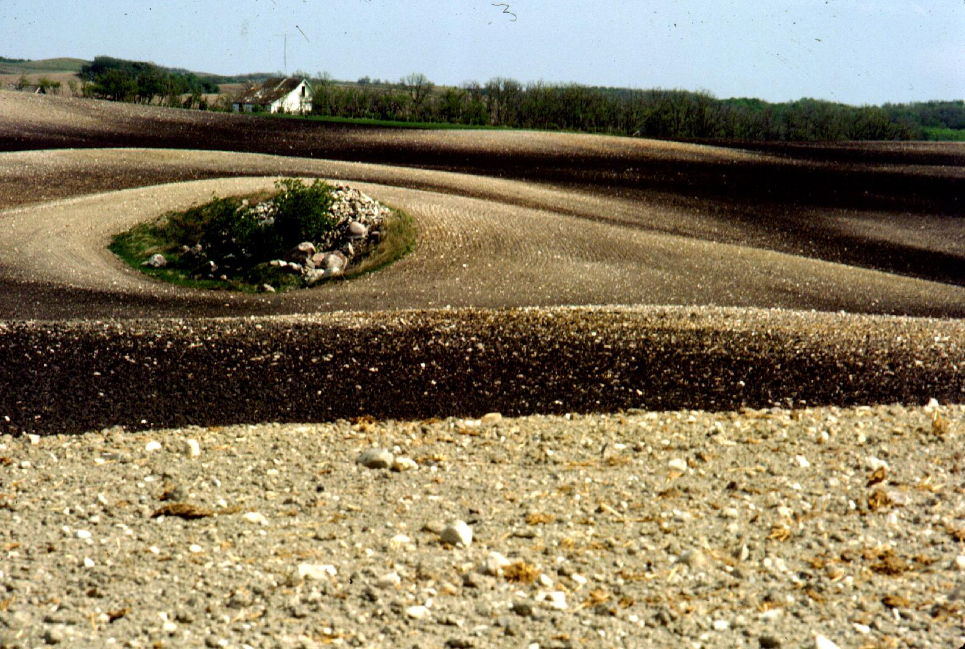
Conclusions
The assessment of soil erosion must consider both the annual rates and cumulative total of soil loss. It is necessary to know the historical impact of soil erosion to target effective management practices to sustain or enhance soil and crop productivity and profitability.
Notes:
The assessment of soil erosion must consider both the annual rates and cumulative total of soil loss. It is necessary to know the historical impact of soil erosion to target effective management practices to sustain or enhance soil and crop productivity and profitability.

Slide 18
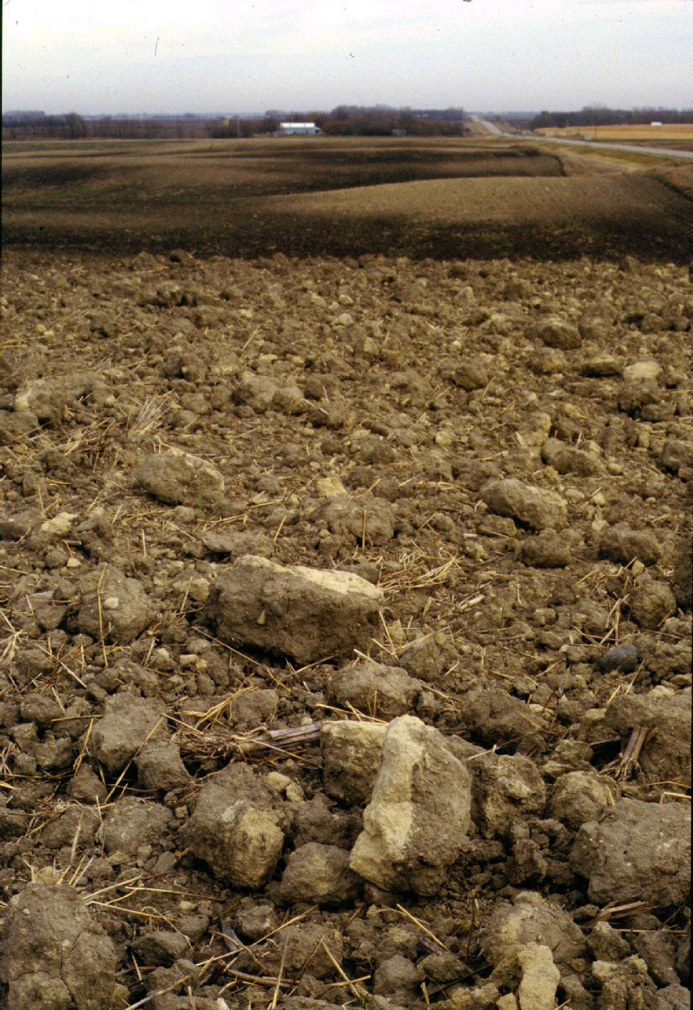
The Way Forward
Conservation tillage simply reduces the loss of soil organic carbon and productivity, we must focus on good crop management to increase organic carbon inputs into the soil and increase soil and crop productivity.
Notes:
Extraordinary measures must be taken to build SOC on moderately to severely eroded land.
Such remediation can be achieved by including crops in rotation that return high levels of stable organic matter to the soil, over crops that don’t. Many crops such as soybeans and potatoes deplete the soil of OC even under conservation tillage. It may be very difficult to achieve a net gain in OC inputs within conventional crop rotations.
Including cover crops in rotation may be an effective means of building SOC.
Importing OC to these areas may be a necessary alternative to growing OC on such areas.
Moving eroded soil back to the hilltops may be the most effective means of restoring the soil-landscape productivity.

Slide 19

Research on and practices to increase soil organic matter and restore soil productivity should be focused on the majority of the area that is not severely degraded, rather than the small percentage that is severely degraded.
Notes:
I would like to comment on feedback that I have received over the past year to this research.
It has been stated that:
“Research on and practices to increase soil organic matter and restore soil productivity should be focused on the majority of the area that is not severely degraded, rather than the small percentage that is severely degraded.” This was described as an approach used in epidemiology.
I would argue that a triage approach to managing production losses resulting from soil loss is the more logical approach.

Slide 20
Notes:
The differences in approach may be a question of scale.
It occurred to me that our assessments may be interpreted as referring to the degradation of land at a farm or regional scale, where severely degraded land could simply be excised and retired. This is incorrect. Our assessments are carried out at the landform scale; calculations are made on individual landform units.
Farmers manage fields, each a mosaic of eroded phases of soil associated with landform position, and they cannot simply exclude eroded areas.
I would argue that the moderately to severely eroded areas should be the focus of efforts to build soil organic matter and soil health. This includes investment in research as well as in the application of practices by farmers.

Slide 21
Where tillage continues, even conservation tillage, the degradation of soil landscapes is increasing in areal extent, more of farm fields are suffering the loss of topsoil. The severely eroded areas are growing.
Notes:
Furthermore…
Where tillage continues, even conservation tillage, the degradation of soil landscapes is increasing in areal extent as well as severity over time. The eroded areas on hilltops are growing in size, meaning more of farm fields are suffering the loss of topsoil. (This is not captured in our assessment.)
This growth in area is a result of progressive tillage erosion. Over time the unproductive subsoil exposed on hilltops gets dragged downslope and buries productive topsoil at the base of hill slopes. This advanced state of degradation is being observed more widely across Canada and should be cause for great concern as the entire land surface losses it productivity.

Slide 22
Soil Health
Land Health
Farm Health
Industry Health
Notes:
And, Finally…
In agriculture, the goal of enhancing soil health is to enhance the health of farms and the health of the industry, to enhance their productive, economic and environmental sustainability.
If efforts to enhance soil health are to be effective, they must consider the soil as part of a landscape that is often complex.
Maybe we should bring back the concept of land stewardship.

