Slide 1
Economic Demands on Soil
Derek Brewin, Agribusiness and Agricultural Economics,
University of Manitoba
2019 Summit on Canadian Soil Health, Oak Hammock Marsh Manitoba, October 2, 2019
Notes:
Hi All;
Many thankago Jim Tokarchuck for this invitation – Jim and I worked for the PFRA – a civil service that had a focus on soil conditions. And there was a lot to worry about back when a third of the land was in summer fallow. And Grain prices were generally low.

Slide 2
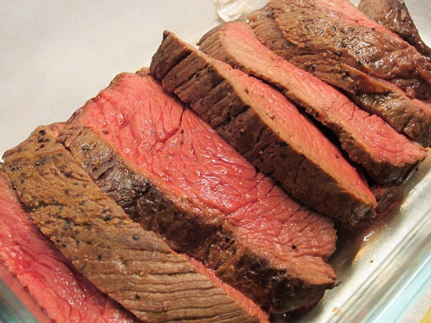
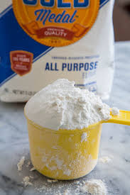
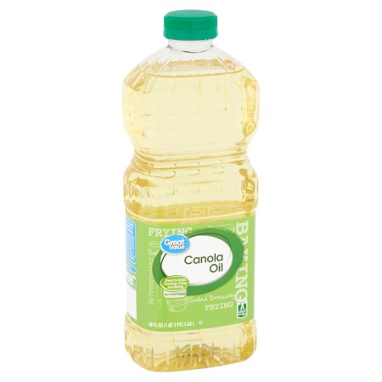
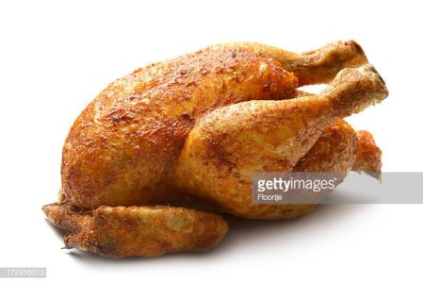
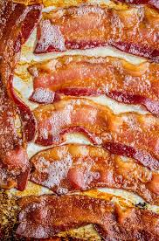
At the End of the Supply Chain
87 million tonnes of grains and oilseed.
21 MT of Flour, 9 MT of Canola Oil, 20 MT of Feed
Notes:
I feel the dominant economic demand now and into the future will be food demand from the consumer. We grow 32 mmt of wheat or around 4mmt of animal feed, and about 21mmt of flour. 20mmt of canola , or 9 MMT of oil and 11mmt of meal. The consumer at the end of the supply chain drives the economics of our supply chains what they are willing to pay for determines the focus of our production. But the demand has been pretty consistent for our wheat and canola and corn and soybeans and barley and oats and the animals fed by these crops.

Slide 3
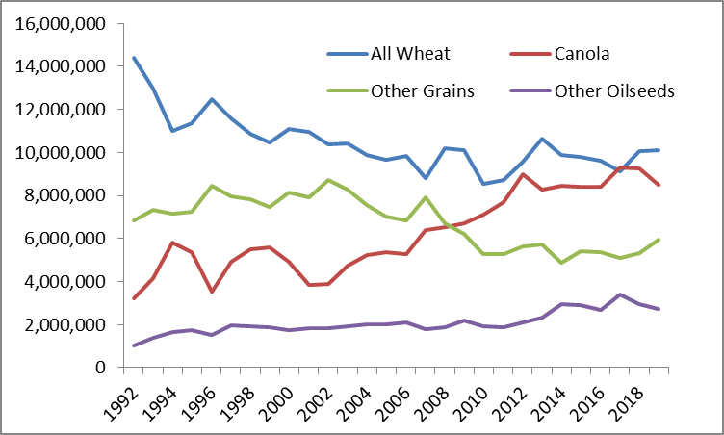
Wheat and Canola dominate most of the land scape
Notes:
The area seeded to Wheat has fallen off since the early 1990’s but it is still often the most dominant crop in terms of area. But canola has been on the rise… this reflects the basic profitabiltiy of that crop to farmers thanks to lots of public and private investments in better seeds and a very steady demand for the superior properties of canola oil.
So some of the reason all that summerfallow we once worried about has started to disappear was glyphosate got cheap – but there was also a great new rotation crop in canola.

Slide 4
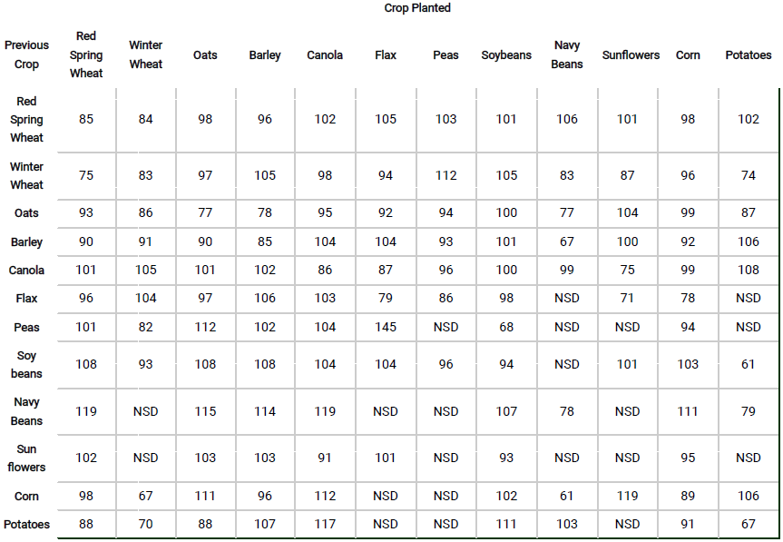
Notes:
One of my recent research focuses has been the economics of rotations. This table is the work of Anastasia Kubinec at Manitoaba Ag. and is based on field level impacts off previous crops on future yields separated by commodities using Manitoba crop insurance data. The left column lists the crop planted on the field previously and the top row lists the current seeded crop and average yield impacts. 100 would be the average yield and any thing higher is a gain in yield linked to the previous crop and anything less is a loss in average yield due to the previous crop.

Slide 5
Notes:
The first story is that continuous cropping is a bad idea – it causes a 6 to 33% yield drop depending on the commodity and a least a 14% drop in wheat and canola.

Slide 6
Notes:
And it is important to note that our two lead commodities do generate positive impacts on each other .. Note their direct impact on each others yield perhaps more important than this but this is from average yields and many farmers in the average were practicing this rotation already.

Slide 7
Notes:
Also important to note the yield impacts of nitrogen fixing pulses especially soybeans on canola, and wheat and corn.

Slide 8
Returns in Rotation (Sakulanda)
Notes:
My student Hazel Sakulanda estimated farmer costs for each of the 5 top crops in Southern Manitoba (no data on Beans), 5 year average yields and 5 year average prices …. That generates the top table and SOYBEANS, CANOLA and CORN look like the top THREE crops in terms of income at the average yield price and cost.
Now look a the impacts of Kubinecs data if we start adjusting average yield by previous crop impacts in rotation … continuous corn even at the very high returns estimated in table 1 becomes a dog compared to soybean corn in rotation because of a 11% yield drop and and soybean corn is higher than just the average of corn and soybeans in first table because of the synergies in that rotation..

Slide 9
Returns in Rotation (Sakulanda)
Notes:
Wheat and canola suffer huge drops in productivity and profits compared to wheat and canola in rotation. And Soybean and Corn turnout to have big synergies and the highest average in come in the area we were researching. So there are two big new drivers on the demands on the soil.

Slide 10
Simulations
Notes:
Hazel was concerned with the variation in prices so she submitted the top ten rotations (OUT OR SOME 3000 POSSIBLE ROTATIONS OF 5 CROPS) to 13 years of available prices collected by Manitoba Agriculture. Soybean corn is the top rotation under 10 of 13 cases and is with in 5% of the top in all years looked at.

Slide 11
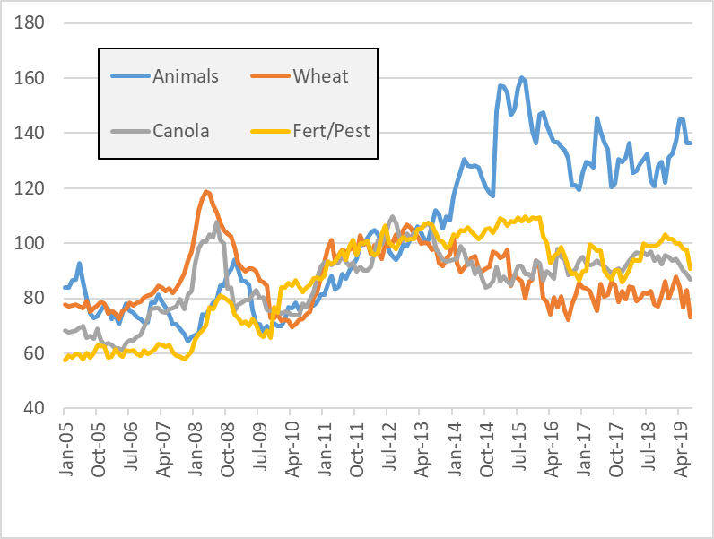
Prices: Wheat, Canola, Live Animals and Inputs (2012=100)
Notes:
But what has been our demand in terms of price offered from the sector? These are Stats Can International Merchandise Trade indexes for 2005 to last month. I think we have been concerned about recent months for grain farm prices but this is really part of a trend since the financial crisis of 2008. Those high prices led to significant production in grains and oilseeds THAT LED TO SURPLUSES THAT killed off those high prices. And WHILE WE SAW A SLIDE IN CROP prices there was an increase in FERT AND Pesticide prices. Live animal prices have been relatively stronger.

Slide 12
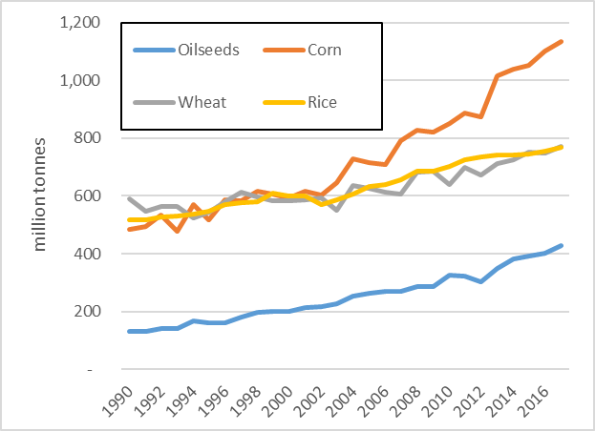
Quantities: World Supply
Notes:
This is FAO Total world production of our major grains. Between 2007 and 2017 corn production has increased 30% and Soybeans and Canola together have increased 37% - Wheat is only up 21% and rice is only up 15%. Some of this difference is the ability to spark innovation in hybrid corn and TUAs for soybeans in the US. But generally the world responded to those price spikes of 2008 with big production gains.

Slide 13
Econ 101 of Nutrient Application
Profit = Yield*P(output) –Input*P(input)
Input has a diminishing impact on Yield
With lower output prices optimal level of input will drop
With higher input prices optimal level of input will drop
Recent price trend points to lower fertilizer application – more demands on current stock of nutrients
Notes:
Read it

Slide 14
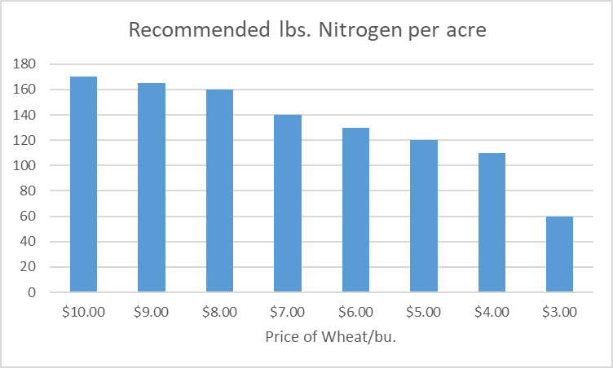
Price Impacts on Inputs (North Dakota State N Calculator)
Notes:
These If N costs $0.60/lb and wheat prices drop N starts to fall at an increasing rate

Slide 15
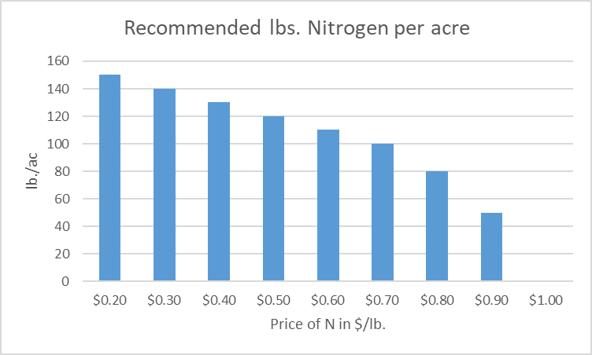
Price Impacts on Inputs
Notes:
At $4/wheat and N prices start to climb – economics N rates drop at an increasing rate and may fall to Zero

Slide 16
Some Final Comments
Consumers Incomes/Preferences are the real demand on the soil
Soybean/Corn rotation is on the rise and rotation is part of the optimal economic choice
As margins get tighter (lower grain prices and higher input) nutrients will be reduced.
Notes:
Read it

Slide 17
THANK YOU!
Hazel, Yiting Li, Rally Liu and Sabrina Reza, Dr. Yvonne Lawley, Project Leader and other research collaborators
These projects are funded by:
Manitoba Corn Growers
Manitoba Pulse and Soybean Growers
Western Grains Research Foundation
Canada and Manitoba governments through Growing Forward 2, a federal-provincial-territorial initiative

Slide 18
References
FAOSTAT – World Production Database.
Kubinec, A., https://www.masc.mb.ca/masc.nsf/mmpp _crop_rotations.html
Manitoba Ag - Guidelines for Estimating Crop Production Costs
MASC MMPP https://www.masc.mb.ca/masc.nsf/ mmpp_crop_rotations.html
MASC MMPP https://www.masc.mb.ca/masc.nsf/ym_ crop_rotation_break_interval_effect.pdf
North Dakota State Wheat Nitrogen Calculator: https://www.ndsu.edu/pubweb/soils/wheat/
Stats Canada - Census of Agriculture and International merchandise trade, by commodity, price and volume indexes.
Sukalanda, MSc Thesis, unpublished, 2018, U of Manitoba

