Slide 1
Summit on Canadian Soil Health 2019
Oak Hammock
Winnipeg, Manitoba
Oct 2, 2019

Slide 2
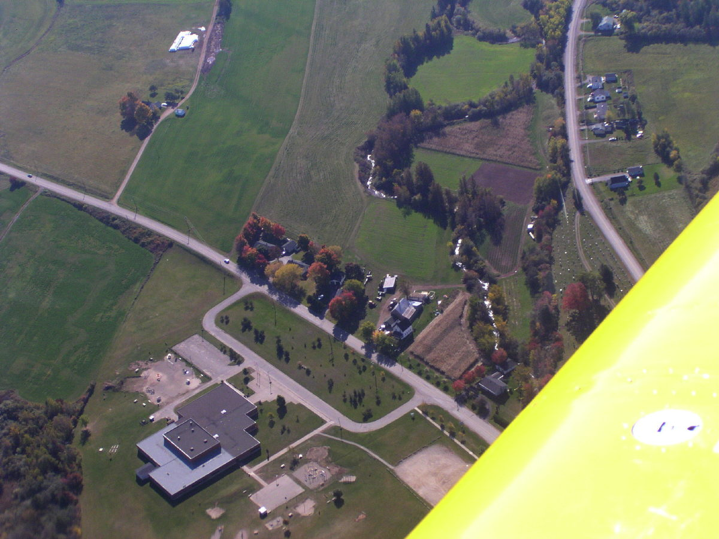
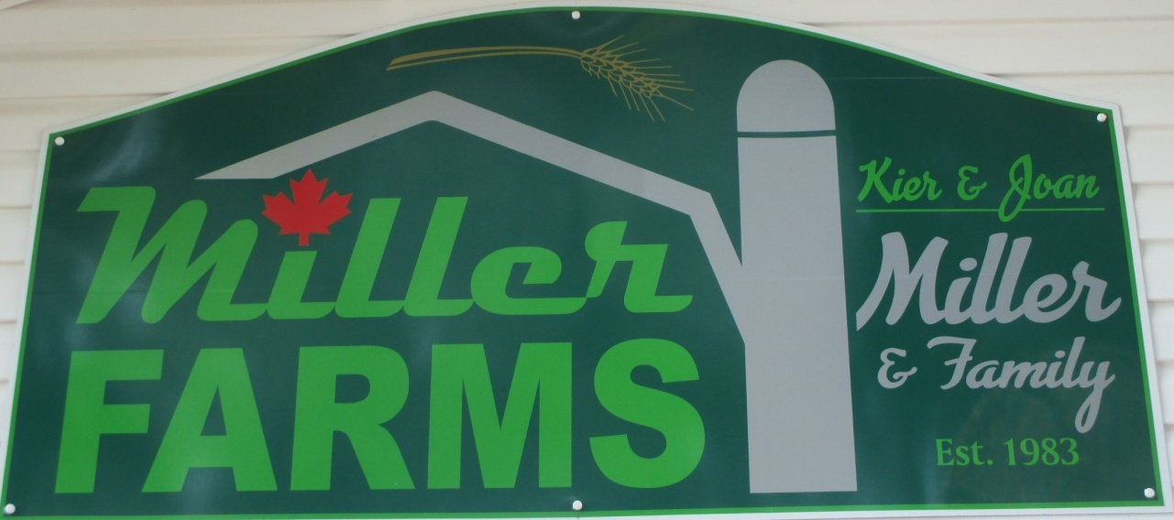
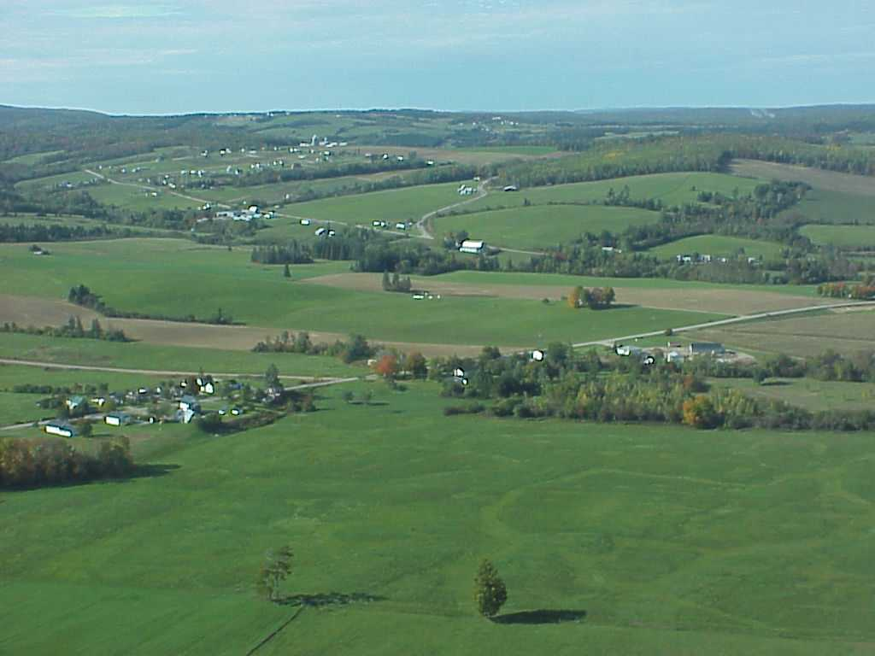
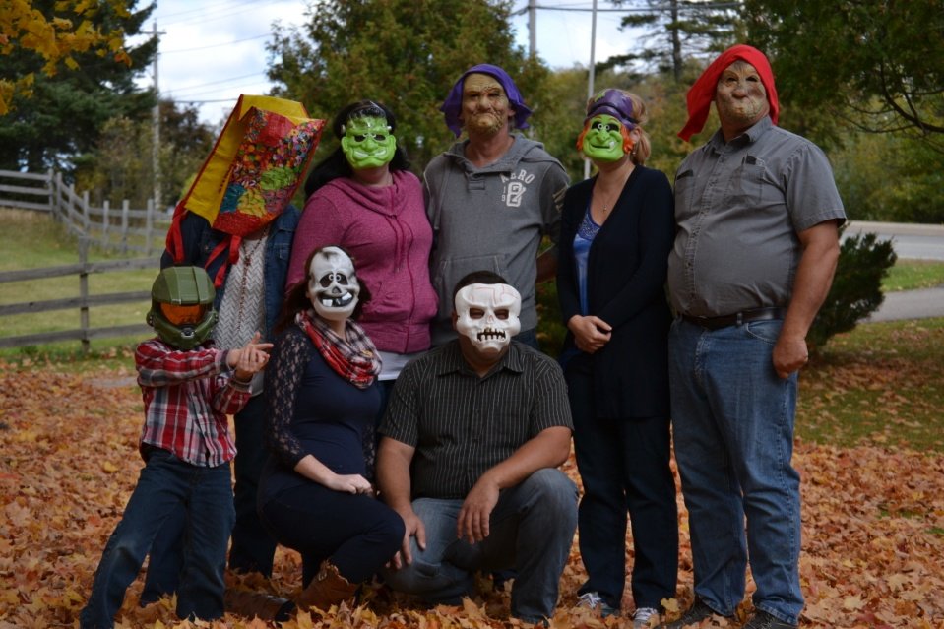

Slide 3
Purchased in 1983
Strawberries and Vegetables1985
Berries 2.5 ac
Vegetables 2 ac
Grain 5 ac
Sunflowers 5 ac
Hay 2 ac
Notes:
Crop acreages varied according to year, vegetables sold through broker, everything else direct sold.

Slide 4
Focus Changed in 2000
NBSCIA
No-Till
SCCC
GHGMP
IFAO

Slide 5
Why No-till
“Wrong Reasons?”
Part time farmer
TIME
Less Cost
Less Fuel
No Rock Picking
“Holistic”
-Global Warming
-Climate Change
-Soil Health
-Carbon Sequestration

Slide 6
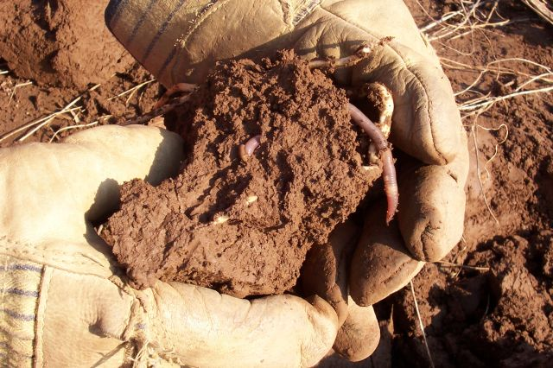
Research said to expect yield drops before recovering.
Soil biology needed to change
Never saw that!

Slide 7
Here’s why
I think
Major crop was forage
My OM’s range 3.7- 5.7
pH’s range 5.7- 6.6
Follow 4Rs
5 yr rotation
Added cover crops

Slide 8
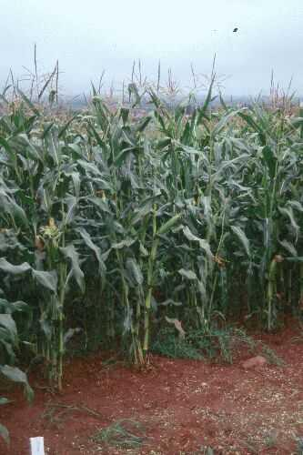
Where we are Now
23 ac owned
225 ac Rented Land
60 ac Grain Corn
70 ac Cereals
50 ac Soybeans
20 ac Dry peas
35 ac Forage
1200-1500ac planting
1200-1500ac combine
Notes:
Essentially because home grown labor force QUIT. Diversification, midlife crisis

Slide 9
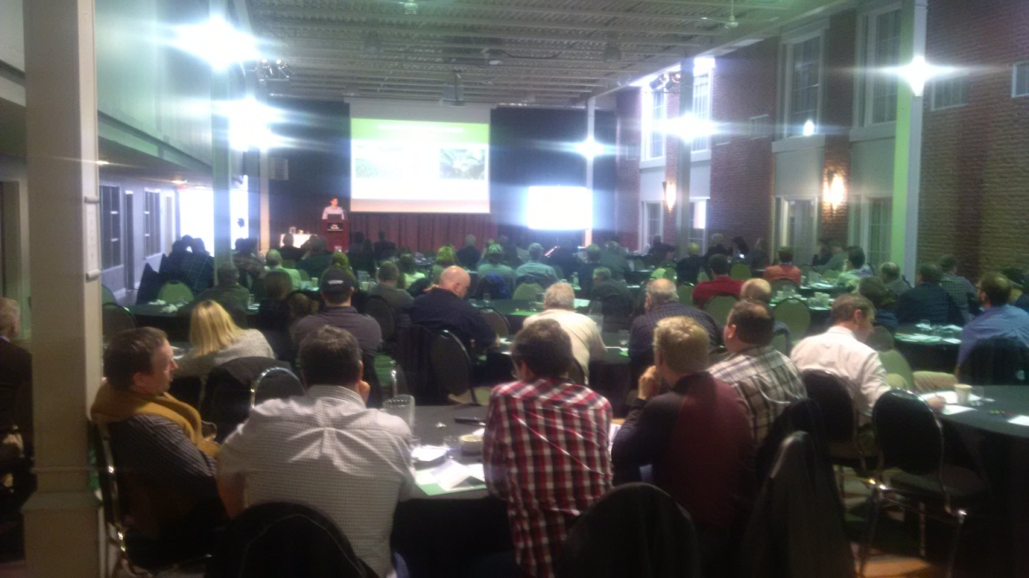
Soil Health
Interest is growing
But Not driven by farmers
Potato processors
Contract conditions
Seed Companies
Cover Crops
Public

Slide 10
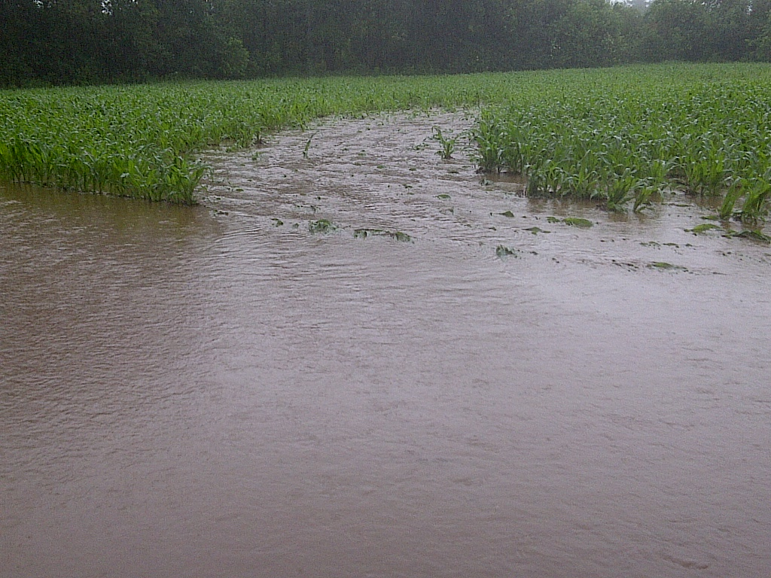
Soil Health
Hindrances
Show Me The Money!
Stuck in a Rut
Unknowns
Logistics
Climate

Slide 11
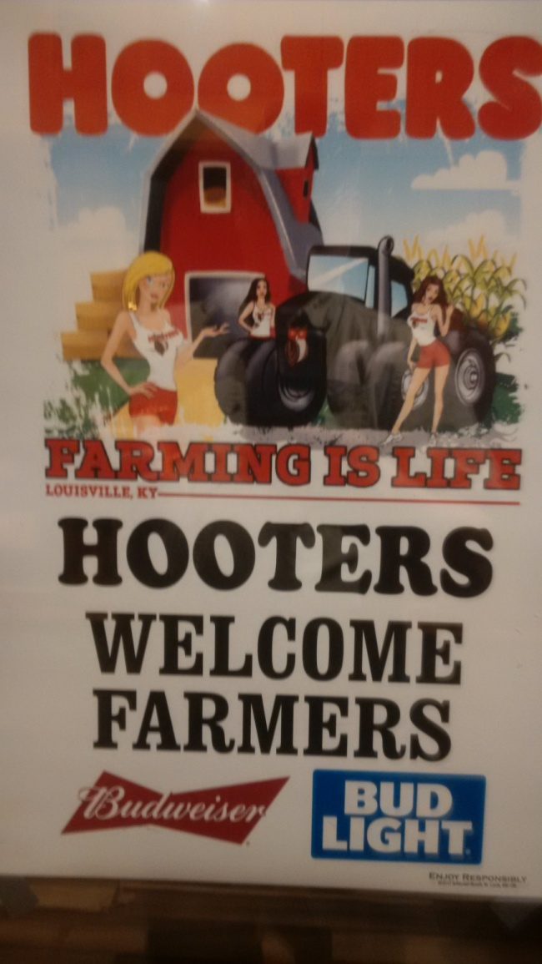
Back to the Future?
Hindsight is said to be 20/20
Do we need to look back?
Peer to peer?
Old Ag pubs talk about cover crops
Non Ag sectors

Slide 12
Thought for the Day
Everyone has an ocean to fly across, if you only have the heart.
Amelia Earhart

