Slide 1
The value of soil 2019 Canadian Summit for Soil Health | October 2019 aitc-canada.ca | @AITCCanada

Slide 2
Who we are
Our organization is here to:
Promote the value of agriculture, sustainable food systems and Canada’s agricultural resource base to students, educators and society.
Provide students and educators with quality educational resources, programs, initiatives, and other agricultural information that is accurate, balanced and current that highlights agriculture as an important part of our economy and way of life.
Enable students to make informed decisions about food choices, food safety, local food supplies and other agricultural products.
Partner with the education, agriculture, health and business communities to develop, implement and evaluate quality initiatives.
Encourage careers in the agriculture sector as a viable, desirable and exciting career choice.
Build relationships between our organization and our stakeholders across Canada.

Slide 3
Meet OUR Provincial Members

Slide 4
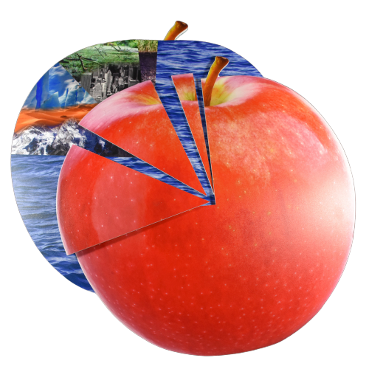
the apple demonstration
Notes:
Hold up the Apple Land Use Model. "This apple represents the planet Earth."
Remove and hold up the 3/4 piece. "Nearly three-quarters of the Earth is covered in water."
Point to the remaining 1/4 of the apple. "The remaining quarter represents land area."
Remove and hold up the 1/8 piece. "This section represents uninhabitable land including deserts, mountains, and polar regions that are not suitable for people to live or grow crops."
Remove and hold up the 3/32 piece. "This section represents habitable, but non-arable land. People can live on this land, but crops cannot be grown because it is too rocky, hot, wet, or it has been developed."
Remove and hold up the 1/32 piece. "Only 1/32 of the Earth's surface has the potential to grow crops. This section represents arable land."
Point to the top layer of dark brown soil. "This small section of topsoil represents all the soil on Earth upon which humans depend for food production."

Slide 5
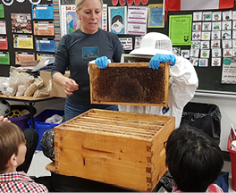
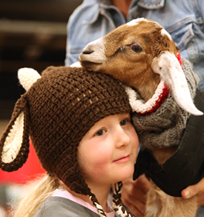
AITC-C’S k-12 approach
Elementary Years
Canadian Agriculture Literacy Month
Middle Years
Journey 2050
High School
What’s Your Something?
The Future
What do we need to do?

Slide 6
Thank You
@MelissaYXE
aitc-canada.ca
MGALAY@AITC-CANADA.CA
1-204-210-0046

