Slide 1
Summit on Canadian Soil Health 2019 Setting the Course for the Future
Opening Remarks
Paul Hoekstra, PhD
Syngenta Canada Inc.
Notes:
Proud to sponsor the Summit on Canadian Soil Health

Slide 2
Adding value sustainably
As a business serving the agricultural industry, we help farmers safely feed a fast-growing world population.
But there’s more: we aim to lead in sustainability.
The Good Growth Plan is not only driving the way we add value to a sustainable agriculture system; it’s measuring the results, so we can quantify the difference we make.
Learn more at www.goodgrowthplan.com

Slide 3
Notes:
The Good Growth Plan is one way we measure and inform the public about how our products and services contribute to sustainable agriculture systems through six commitments.
One of our commitments under the GGP is our commitment to Rescue more farmland,
We have committed to improve the fertility of 10 million hectares of farmland on the brink of degradation by 2020 – an area the size of Iceland.
Through this commitment we help farmers improve soil quality, resulting in more carbon retention in soil, enhanced water holding and soil fertility, and less erosion from sustainable soil management practices, including conservation agriculture.
Four years into our soil commitment, we have benefited a total of 10 million hectares with sustainable soil management practices through over 150 projects in 40+ countries.

Slide 4
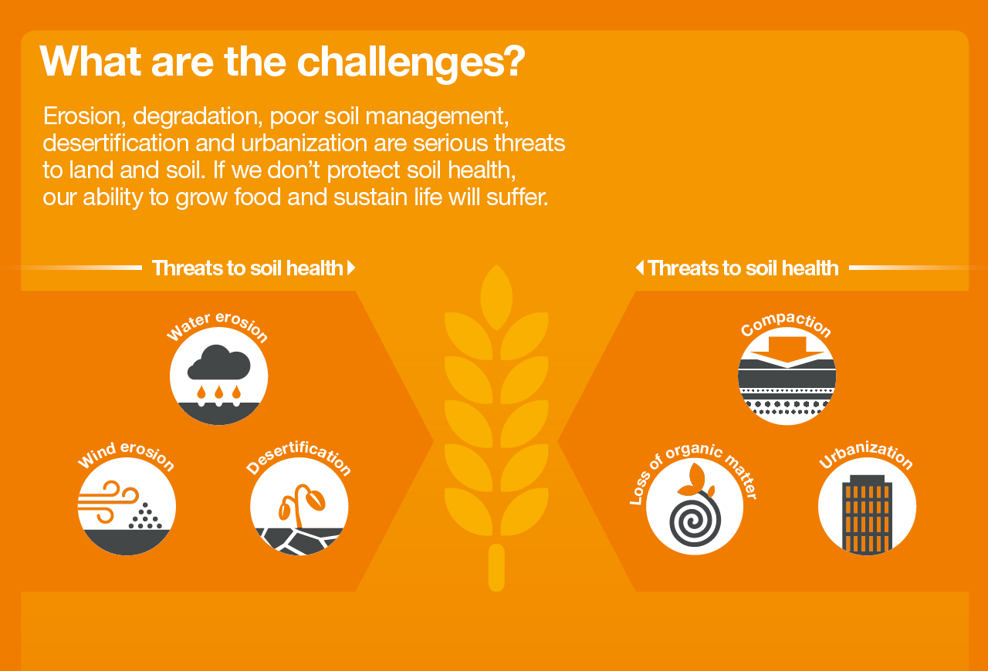

Slide 6
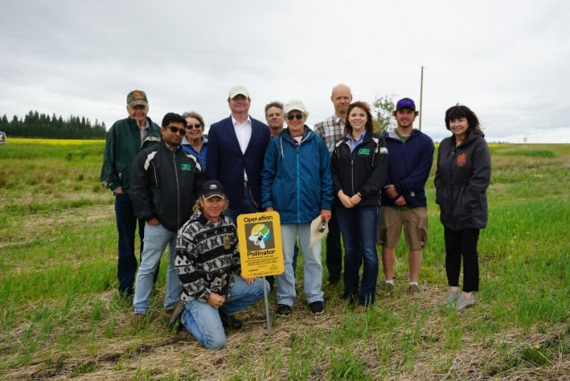
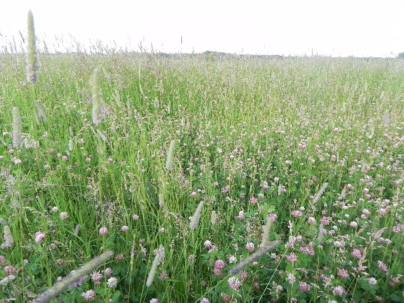
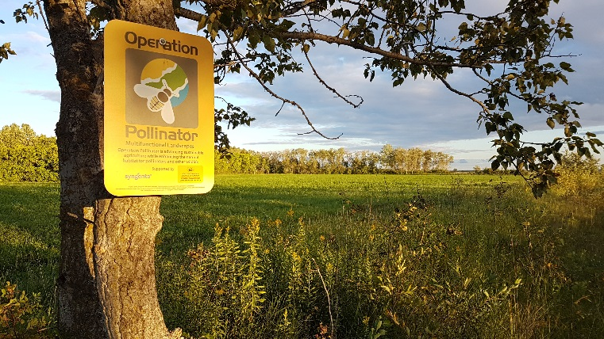
Proud supporter of Soil Conservation Council of Canada (e.g. Operation Pollinator; a multi-year biodiversity initiative)
133 sites across four provinces
Ontario ` | Manitoba | Saskatchewan | Alberta
33 | 34 | 28 | 38
Notes:
Collaboration is key… Proud to be a support of SCCC on complex environmental issues like soil health and biodiversity
To enroll, participants agreed to convert one-to-two acres of lower-productivity land to establish a dedicated Operation Pollinator site.

Slide 7
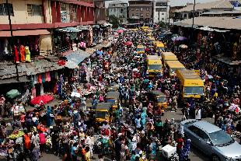
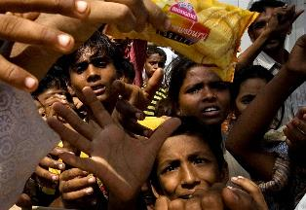
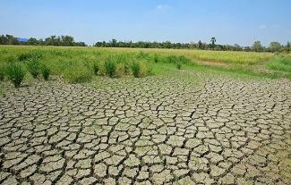
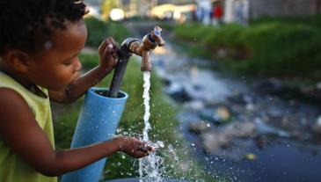
We are committed to finding better ways to safely feed the world sustainably
Every day the world’s population
increases by 200,000
870 million people go to bed hungry
Agriculture produces 30% of greenhouse gases and 40% of soil is degraded
By 2050, 5bn people will live with water scarcity – agriculture uses 70% of fresh water
Notes:
The world is facing complex challenges
Complex challenges require us to work together; to encourage dialogue and sharing of ideas among sectors and groups
Health soil is the foundation to solving these issues
That’s why we’re proud to support this Summit and thank-you for your interest and energy that you bring to the event and this important topic.

Slide 8
Paul Hoekstra, PhD
Manager, Government and Industry Relations
paul.hoekstra@syngenta.com

